Slide 1
TRTR-2013
CONCEPTUAL STUDY OF
LOW-POWER RESEARCH REACTOR
FOR EDUCATION AND TRAINING
H. KIM, C. Park, J. Park and B. Lee

Slide 2
Contents
Introduction
Basic requirements
Preliminary analysis
Neutronic calculations
T/H calculations
Concluding remarks

Slide 3
Introduction
Over the world,
Decreasing trends of RRs due to aging and under-utilization
60% of 250 RRs in operation are less than 250kW
Supplier of a low-power RR become fewer
RR’s role will continue as long as nuclear energy is used for peace
In Korea,
KAERI’s experiences on high power RRs :
HANARO(30MW), JRTR(5MW), KJRR(15MW), PALLAS(80MW)
Possibility of a low-power RR for education and training for University
A conceptual study to develop a reference model of a low-power RR
High safety and economy with flexibility in utilization

Slide 4
Basic Requirement
Major top-tier requirements for education/training RRs
Flexibility | Core configuration & structure : Simple, Easy change of core structure, Easy access to core & Exp. facilities Utilization area : Field education, Rx. Exp., Neutron beam & Radiation utilization Core power : Easily operable from zero to full power including transient
Safety & Security | Reactivity : Rx. to avoid uncontrolled power transient (limited excess reactivity, limited reactivity insertion rate, negative reactivity feedback) Cooling : Cooling by natural circulation. No emergency cooling Radiation safety : ALARA Security : Physical and Cyber security
Economy | Low construction cost Fuel cost : Manufactured with proven technology to secure stable supply (LEU fuel, No cost for spent fuel disposal) Min. operation and maintenance costs : designed to be easily maintained (Min. operators, Maintenance free design, Use of commercial components)

Slide 5
Preliminary Design Features
Reactor Type | Open-Tank-In-Pool
Thermal Power (kW) | 250
Max. Thermal Neutron Flux (n/cm²·sec) | >5.0×10¹² in the core
Fuel Type & Material | Rod type or Plate type U-Mo with 19.75% enrichment (LEU)
Coolant & Cooling Method | H₂O Natural circulation
Moderator/Reflector | H₂O/Graphite
Reactor safety | High negative feedback Inherent & passive characteristics
Reactor Control | Digital technology Control rod - Hf, SUS
Experimental facilities | Vertical holes for RI production, NAA, PTS, HTS etc. 2 Beam tubes for NR, BNCT

Slide 6
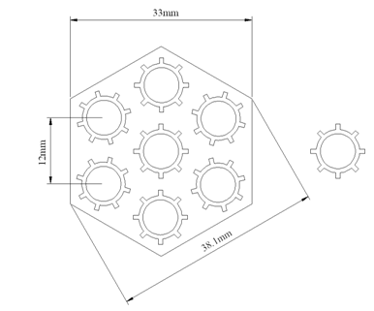
Preliminary neutronic analysis -1
Numerical analysis method
MCNP-5 : Criticality, Neutron flux
TRITON-NEWT : Burn-up estimation
ENDF/B-VII library
Rod type fuel assemblies
Remove outer-most ring of HANARO 36-rods standard fuel assembly
7 Fuel rods (no tie rod)
Ass. Dimension : 36 X 570 (mm)

Slide 7
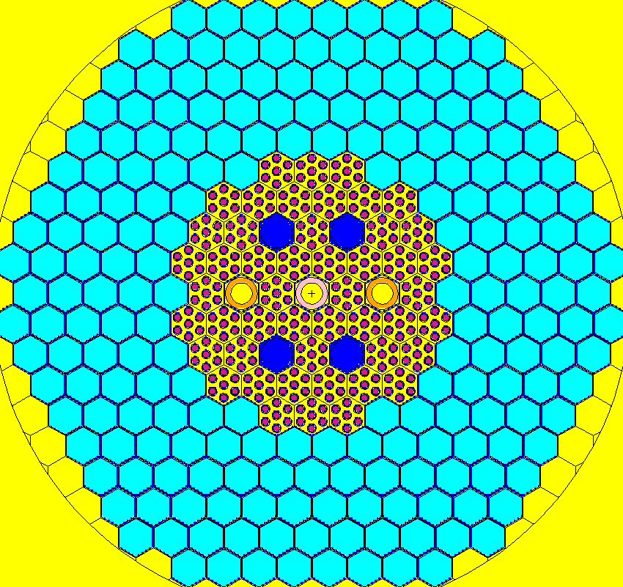
Preliminary neutronic analysis -2
250kW – Rod type core
Core : 48 fuel assemblies
Total 336 fuel rods
4-incore irradiation holes
2-shim rod (Hf)
1-regulating rod (SUS)
D=27cm
H=50cm
Fuel : U-7Mo
5gU/cc, 6gU/cc,
7 rods/assembly
Avg. linear power :
1.5 kW/m at 250 kW
5gU/cc
Keff = 1.04341 (ARO)
= 0.91044 (ARI, SUS) = 0.93009 (SRI)
6gU/cc
Keff = 1.05515 (ARO)
= 0.92799 (ARI, SUS) = 0.94599 (SRI)

Slide 8
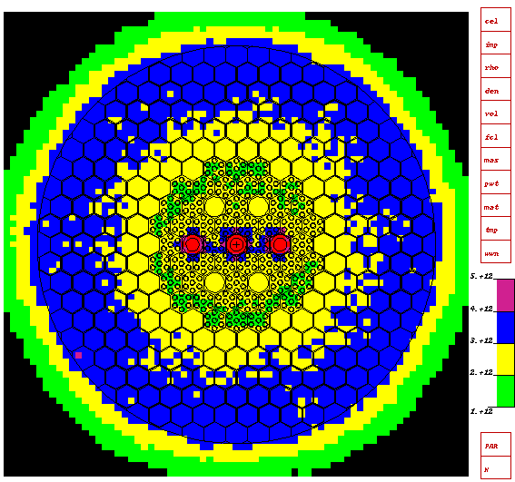
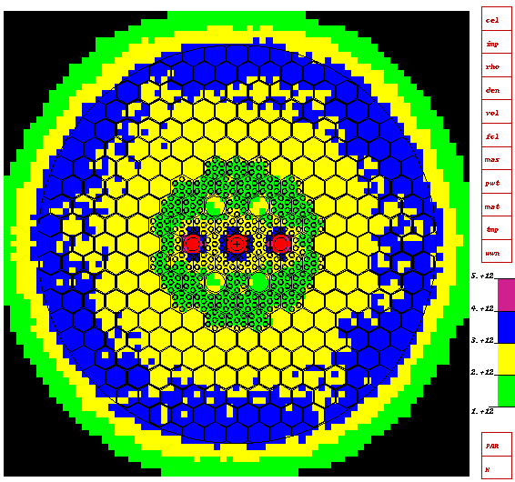
Preliminary neutronic analysis -3
Thermal neutron flux Dist.
5gU/cc
6gU/cc
Neutron flux > 3.0E12
Neutron flux > 3.0E12
F/M ratio adjusting

Slide 9
Preliminary neutronic analysis -4
Plate type fuel assemblies
Ass. Dimension : 76.2 X 76.2 (mm)
Meat Dimension : 62.0 X 0.51 X 450 (mm)
Clad/water thick. : 0.38 / 2.35 (mm)
21/15 Fuel plates
Hf Dimension : 64.6 X 3.97 X 450 (mm)
2 Hf plates
Standard fuel assembly
Control fuel assembly
U-235 loading (g)
5gU/cc | 295
6gU/cc | 354
7gU/cc | 413
8gU/cc | 472
U-235 loading (g)
5gU/cc | 211
6gU/cc | 253
7gU/cc | 295
8gU/cc | 337

Slide 10
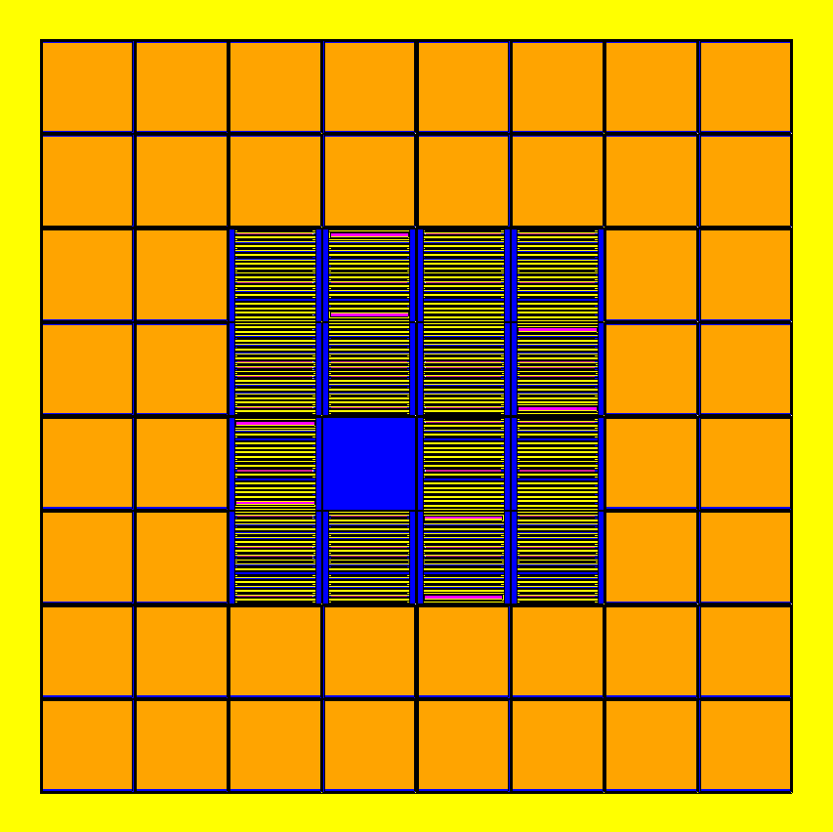
Preliminary neutronic analysis -5
250kW – Plate type core
 | U-235 loading (kg)
5gU/cc | 4.09
6gU/cc | 4.91
7gU/cc | 5.73
8gU/cc | 6.54
 | Keff
 | ARO | ARI
5gU/cc | 1.06745 (0.00036) | 0.86832 (0.00039)
6gU/cc | 1.08671 (0.00037) | 0.89365 (0.00038)
7gU/cc | 1.09954 (0.00038) | 0.91277 (0.00038)
8gU/cc | 1.11085 (0.00039) | 0.92772 (0.00038)
Avg. heat flux = 15.40 kw/m²

Slide 11
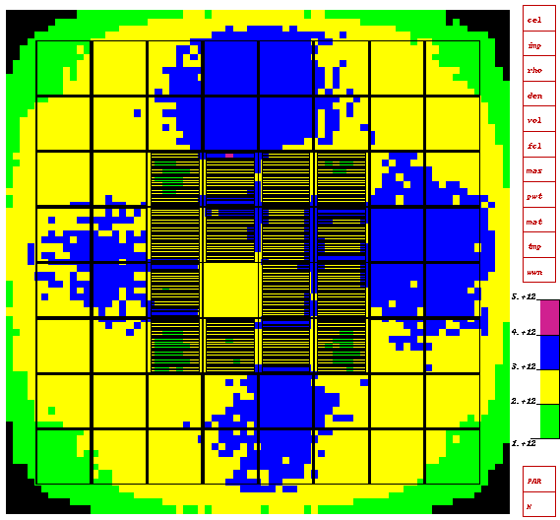
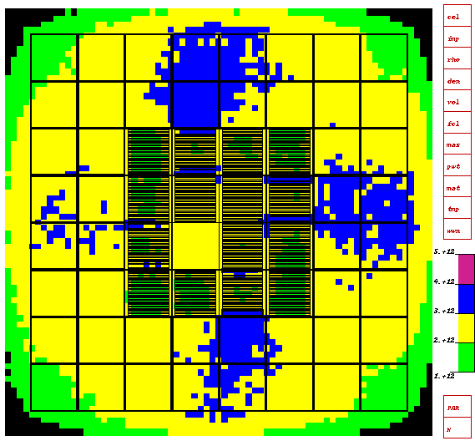
Preliminary neutronic analysis -6
Thermal neutron flux Dist.
5gU/cc
6gU/cc
Neutron flux > 5.0E12
Neutron flux > 5.0E12

Slide 12
Preliminary neutronic analysis -7
Rod fuel vs. Plate fuel core
CORE | Mass of U-235 (kg) |  | Criticality / Cycle length
 | Rod | Plate | Rod |  | Plate
 |  |  | ARO | Days | ARO | Days
5gU/cc | 5.25 | 4.09 | 1.04341 | 3950 | 1.06745 | 4050
6gU/cc | 6.31 | 4.91 | 1.05515 | 6100 | 1.08671 | 6500
7gU/cc | 7.36 | 5.73 | - | - | 1.09954 | 8700
8gU/cc | 8.41 | 6.54 | - | - | 1.11085 | 11000

Slide 13
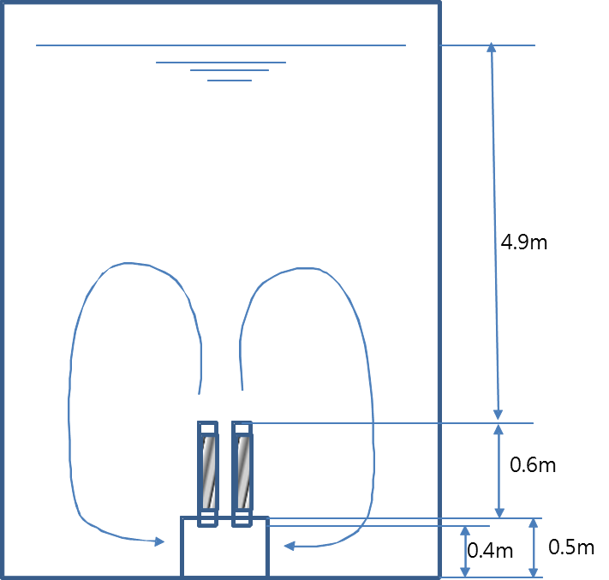
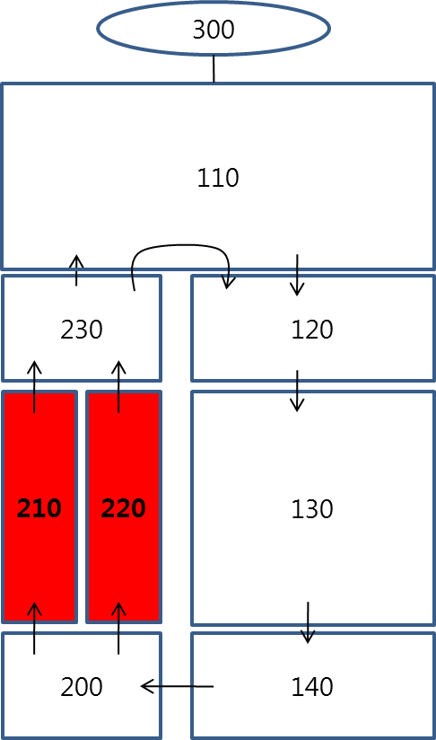
Preliminary T/H analysis -1
Parameters of interest
Max. ONB temperature
Min. CHFR
By using MARS code
Assumptions
Pool temperature : 35ºC
Total & axial peaking factor : 3.0 & 1.34
Elevations :
Nodalization for MARS calculations
Quasi-steady state calculation
ONB temp. : 120ºC

Slide 14
Preliminary T/H analysis -2
Calculation Results : Coolable by natural circulation
 | Power (kW) | Coolant vel. (m/s) | Coolant temp. (℃) | Fuel temp. (℃) | CHFR
Rod | 500 | 0.27*/0.23** | 86*/66** | 132*/109** | 8.7*/-
 | 250 | 0.19*/0.15** | 59*/50** | 120*/95** | 13.0*/-
 | 100 | 0.12*/0.09** | 49*/43** | 103*/70** | -/-
Plate | 1000 | 0.25*/0.21** | 83*/57** | 117*/80** | 35.7/-
 | 750 | 0.23*/0.18** | 74*/55** | 110*/74** | - / -
 | 500 | 0.20*/0.14** | 66*/52** | 94*/67** | - / -
 | 250 | 0.13*/0.093** | 58*/48** | 78*/54** | - / -
 | 100 | 0.076*/0.052** | 51*/44** | 63*/51** | - / -
Hot channel*/ Avg.**

Slide 15
Concluding Remarks
A conceptual study to develop a reference model of a low power RR is being performed to prepare for future needs
Fundamental requirements
Preliminary analysis for rod type and plate type cores
→ controlable, coolable, and feasible
A reference model will have high safety and economics together with high flexibility in use

