Slide 1
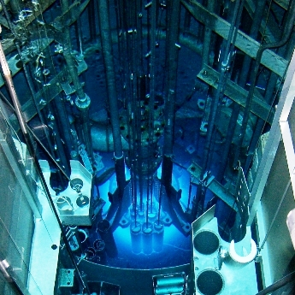
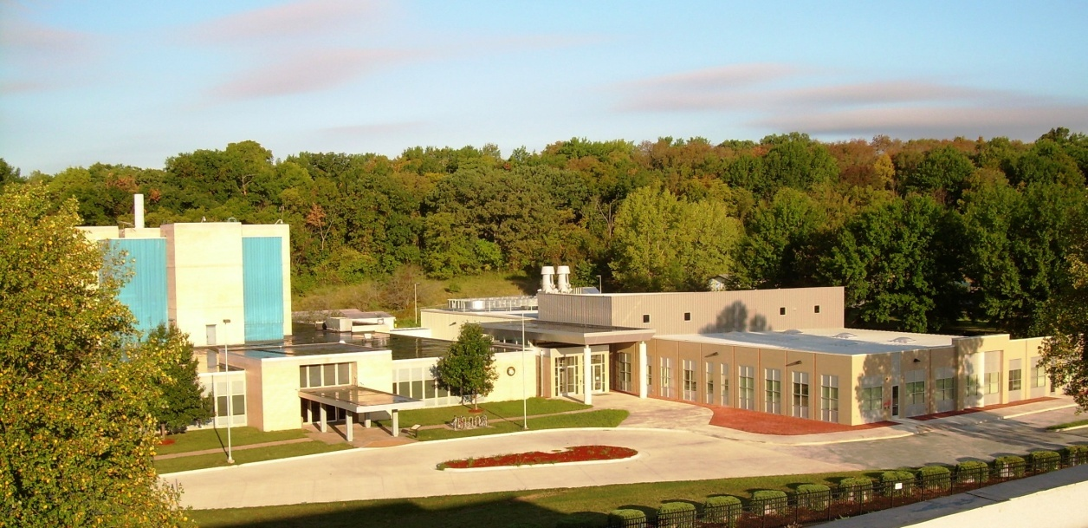
The University of Missouri Research Reactor
HEU to LEU Fuel Conversion Project Status
Leslie P. Foyto¹, Kiratadas Kutikkad¹,
J. Charles McKibben¹ and Nickie Peters¹
Earl Feldman², John Stillman² and John Stevens²
1. University of Missouri-Columbia Research Reactor
2. Argonne National Laboratory
TRTR Meeting – September 23-26, 2013
University of Missouri (MURR); St Louis, MO

Slide 2
Presentation Overview
2
General Description of the Reactor and Fuel
LEU Contingency Core Design - “CD35”
LEU Core CD35 Steady-State Safety Basis
Peak Fuel Temperatures during a LOF and LOC Accident using RELAP - CD35 Core
Fuel Conversion Affects on Beryllium Lifetime
Transition Fuel Cycle - CD35 Core
Summary of Recent Accomplishments
TRTR Meeting – September 23-26, 2013
University of Missouri (MURR); St Louis, MO

Slide 3
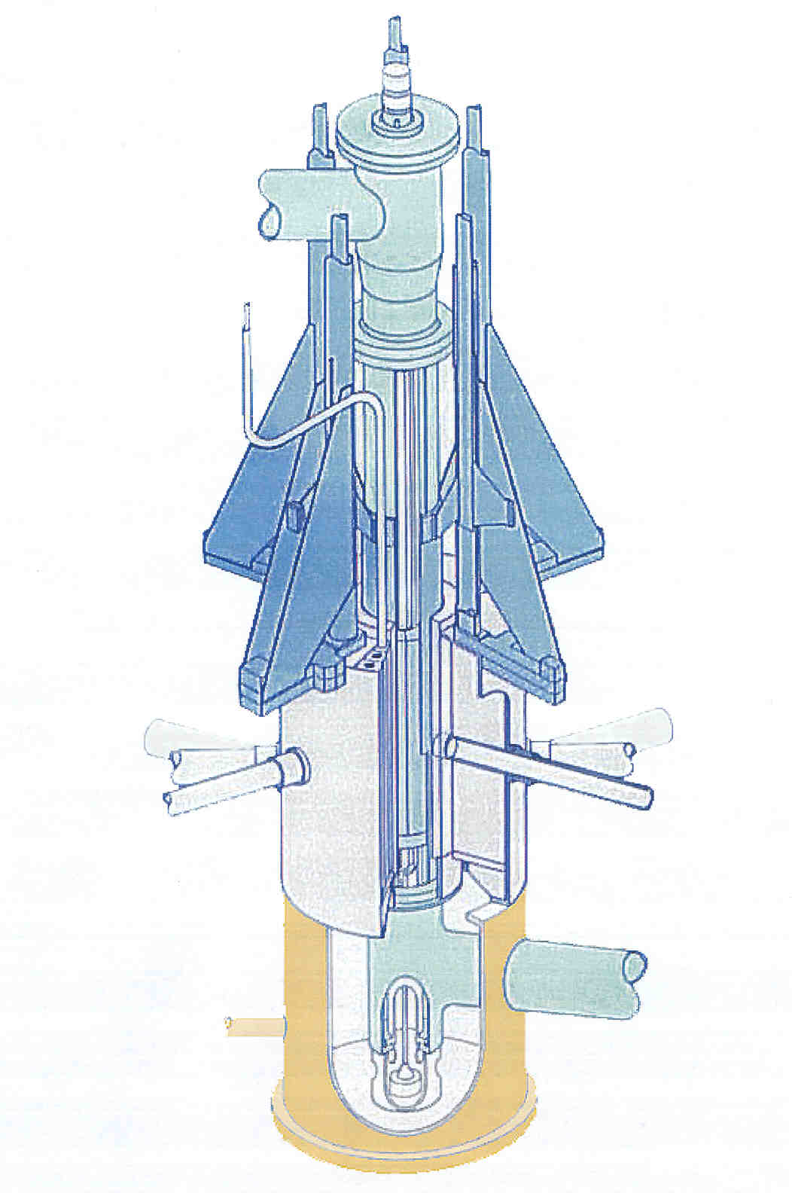
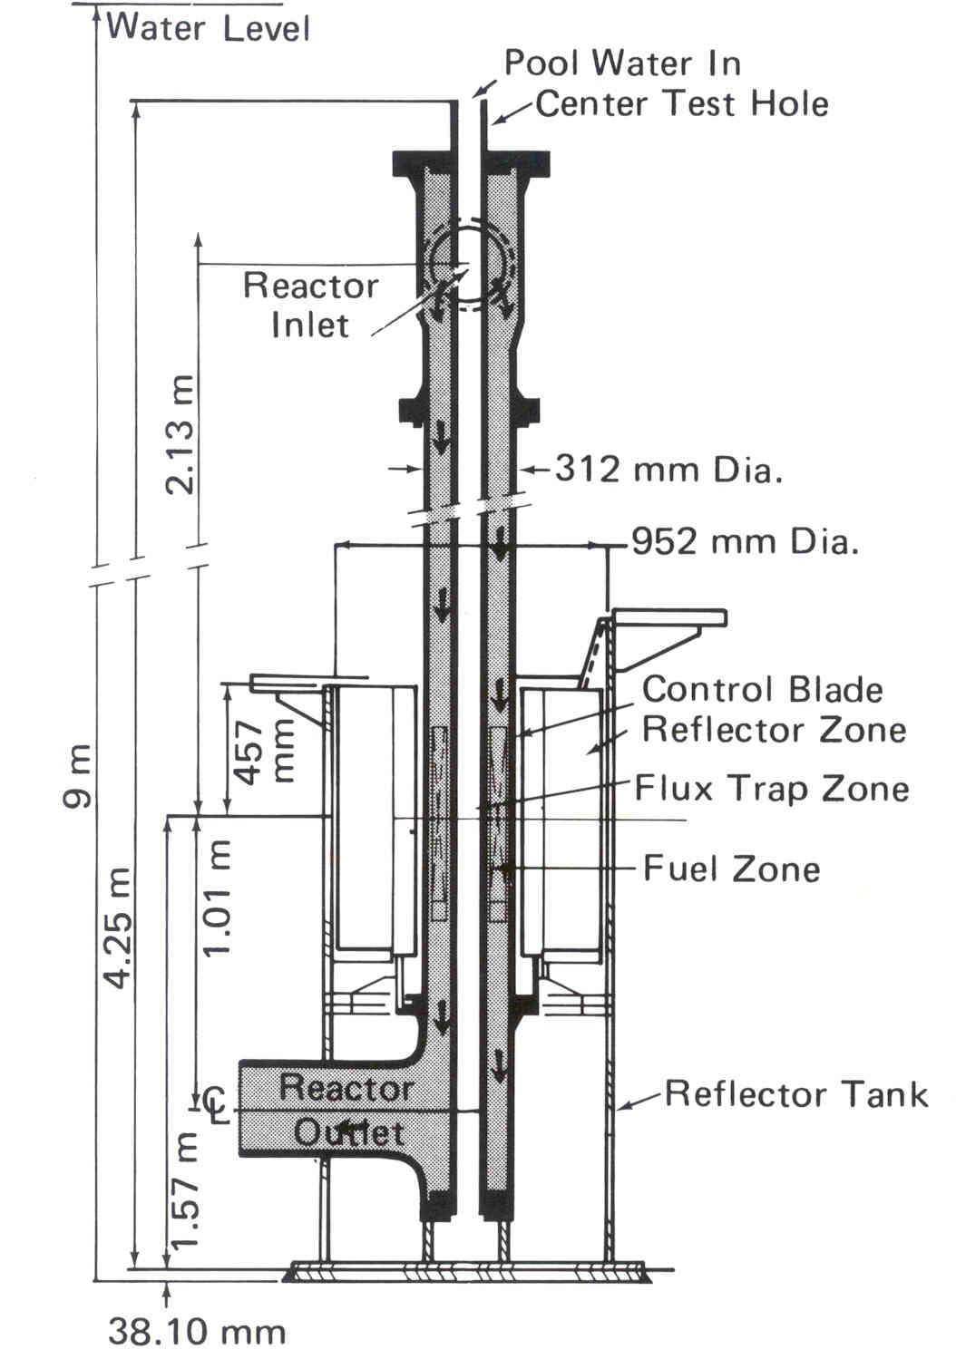
3
Reactor Core Assembly
3D View
Reactor Core Assembly
2D View
Very Compact Core Design
Core Volume:
33 liters
Fuel Meat Volume:
4.3 liters
TRTR Meeting – September 23-26, 2013
University of Missouri (MURR); St Louis, MO

Slide 4
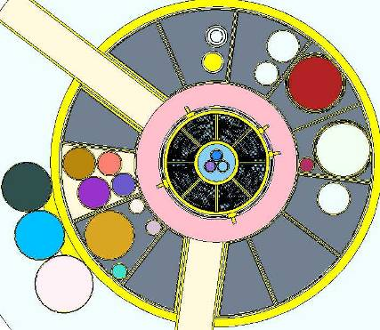
Cross Section View of Core (MCNP Model)
4
2-inches
Below Core Centerline
Beryllium Spacer
Beryllium Reflector
Graphite Reflector
Beamport
(1 of 6)
Fuel Element
(1 of 8)
Control Rod
(1 of 4)
Flux Trap
TRTR Meeting – September 23-26, 2013
University of Missouri (MURR); St Louis, MO

Slide 5
Development of LEU Core CD35 Design
5
Feasibility Study Design (FSD): 24 variable thickness U-10Mo foils with minimum 10 mil clad (Al + Zr interlayer)
Element redesigned with nominal clad thickness
≥ 12 mil
Fuel design optimized for lifetime and power peaking
“CD35” has 23 plates; thicker minimum plate thickness than FSD; same lifetime as HEU
Note: Plate 1 is the innermost plate, Plate 23 or 24 is the outermost plate.
Elem10 ent Design |  | FSD | CD35
Fuel Foil Thickness (mil) | Plate 1 | 9 | 9
 | Plate 2 | 12 | 12
 | Plate 3 | 18 | 16
 | Plates 4-22 | 18 | 20
 | Plate 23 | 18 | 17
 | Plate 24 | 17 | N/A
Clad Thickness (mil) | Plate 1 | 20 | 17.5
 | Plate 2 | 13 | 16
 | Plate 3 | 10 | 14
 | Plates 4-22 | 10 | 12
 | Plate 23 | 10 | 16
 | Plate 24 | 16 | N/A
Plate Thickness (mil) | Plate 1 | 49 | 44
 | Plates 2-22 | 38 | 44
 | Plate 23 | 38 | 49
 | Plate 24 | 49 | N/A
Coolant Channel Thickness (mil) | Channel 1 | 95 | 95.5
 | Channels 2-5 | 92 | 93
 | Channels 6-19 | 92 | 92
 | Channels 20-23 | 92 | 93
 | Channel 24 | 92 | 95.5
 | Channel 25 | 95 | N/A
TRTR Meeting – September 23-26, 2013
University of Missouri (MURR); St Louis, MO

Slide 6
Current HEU and Proposed LEU Core CD35 Fuel Cycles
6
TRTR Meeting – September 23-26, 2013
University of Missouri (MURR); St Louis, MO

Slide 7
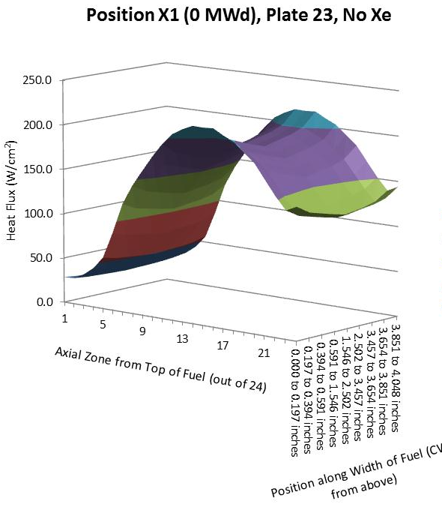
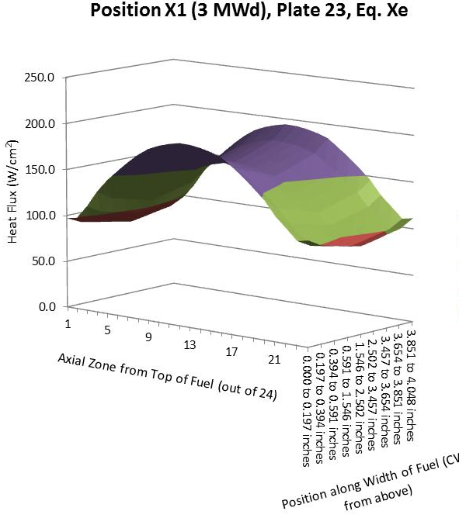
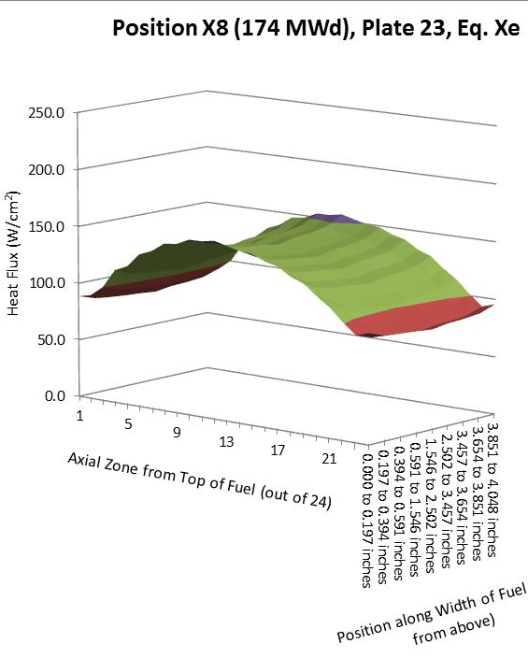
Power Distributions for Steady-State FI and CHF Analyses
7
As elements reach end-of-life, peak heat flux becomes less
However, flow instability (FI) could occur at lower power in channel of depleted element; fuel swelling and oxide growth constricts coolant channel
148.1 W/cm²
218.1 W/cm²
156.8 W/cm²
196.7 W/cm²
128.2 W/cm²
155.5 W/cm²
Upper value is Hot-Strip Heat Flux
Lower value is Hot-Spot Heat Flux
TRTR Meeting – September 23-26, 2013
University of Missouri (MURR); St Louis, MO

Slide 8
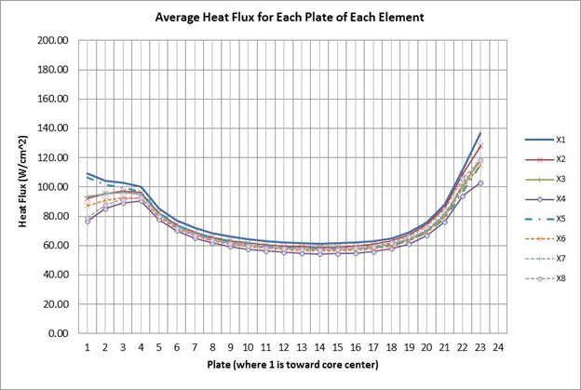
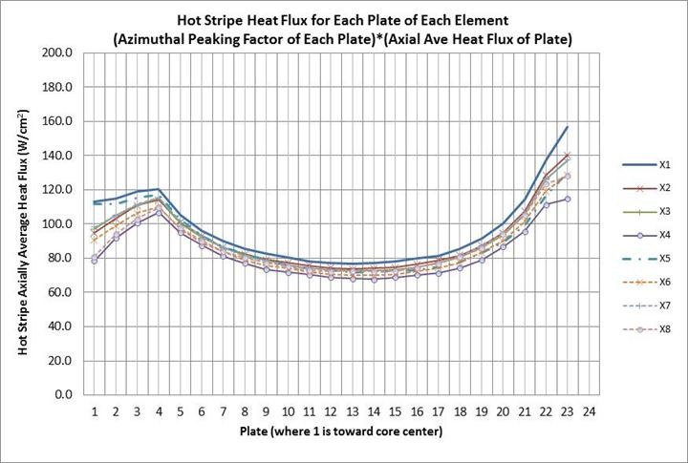
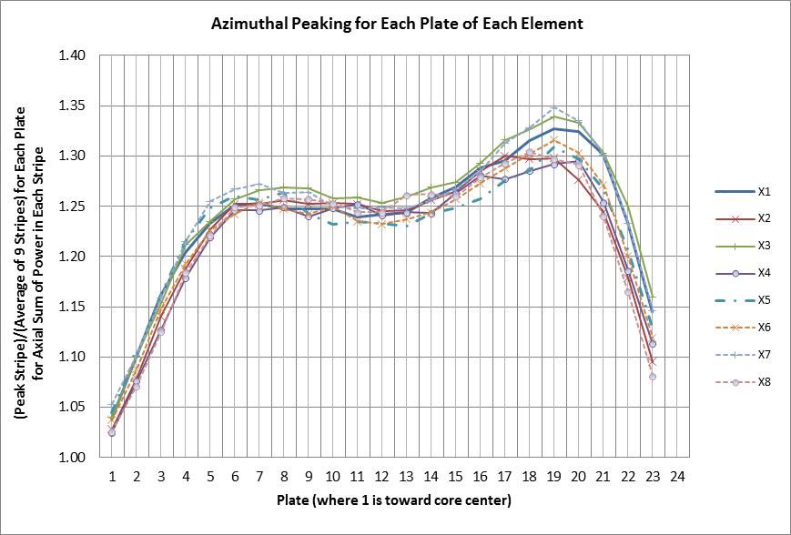
Power Distributions for Steady-State FI and CHF Analyses
8
Greatest CD35 hot stripe heat flux in case for:
Reference core
Equilibrium Xe
Samples in Flux Trap
Control Blades A&D depleted and positioned 1 inch above Blades B&C
TRTR Meeting – September 23-26, 2013
University of Missouri (MURR); St Louis, MO

Slide 9
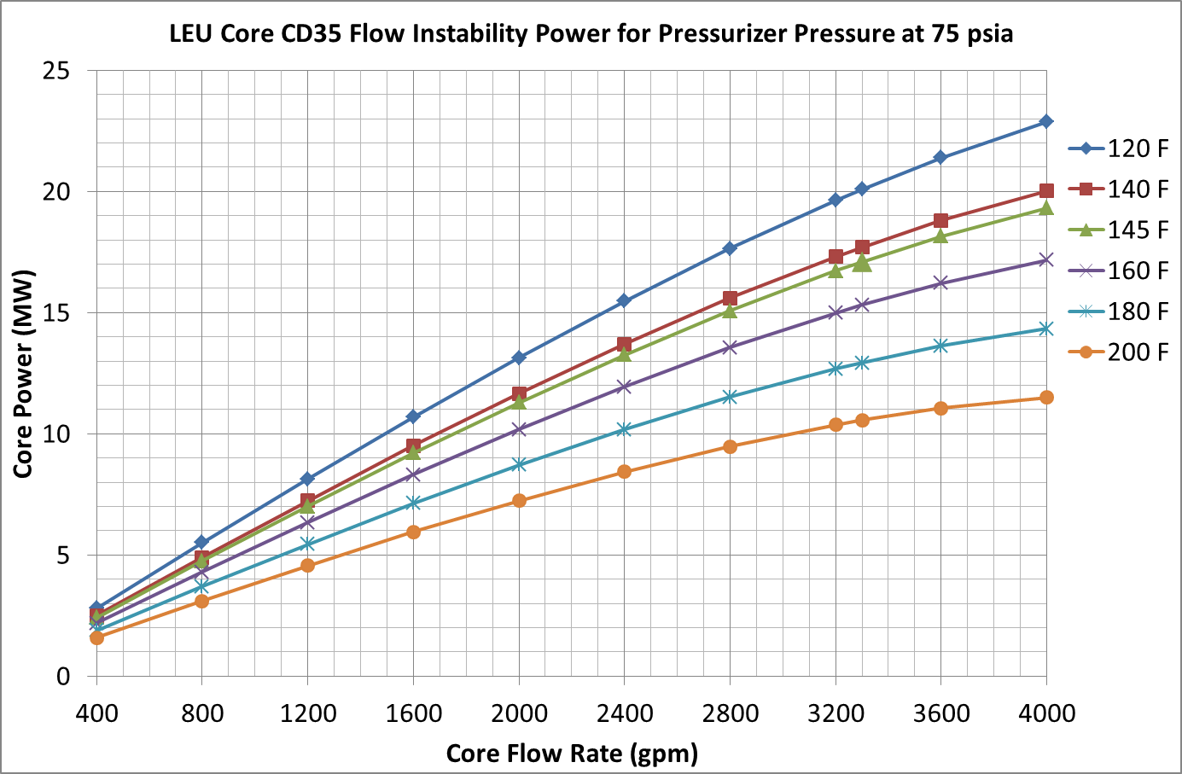
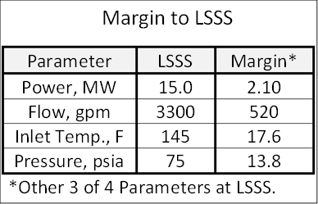
LEU Core CD35 Flow Instability Power at 75 psia
9
Max. Power
Inlet Temp.
Min. Flow
Flow Margin
TRTR Meeting – September 23-26, 2013
University of Missouri (MURR); St Louis, MO

Slide 10
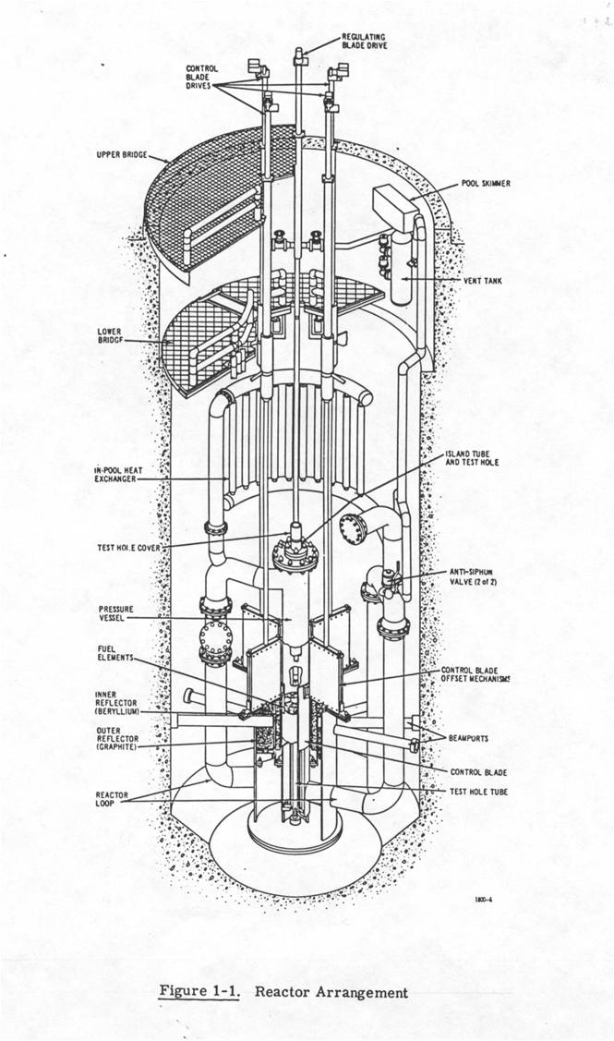
Loss of Flow Accident
10
Normal Flow Path
Accident Flow Path
TRTR Meeting – September 23-26, 2013
University of Missouri (MURR); St Louis, MO

Slide 11
Loss of Coolant Accident
11
Start of Accident
Coolant Left in Primary
TRTR Meeting – September 23-26, 2013
University of Missouri (MURR); St Louis, MO

Slide 12
CD35 LOF and LOC Accidents Fuel Plate 23 Centerline Temperature
12
TRTR Meeting – September 23-26, 2013
University of Missouri (MURR); St Louis, MO
Notes:
LEU core inlet temperature is 145 F LSSS HEU SAR: inlet temperature is 155 F LSSS
HEU SAR peak fuel temperatures were:
Cold leg LOCA fuel peak temperature is 312 F
Hot leg LOCA fuel peak temperature is 281 F
LOFA fuel peak temperature is 280
So LEU peak fuel temperatures higher with LEU by
34 F in the Cold Leg LOCA
28 F in the Hot Leg LOCA
42 F in the LOFA

Slide 13
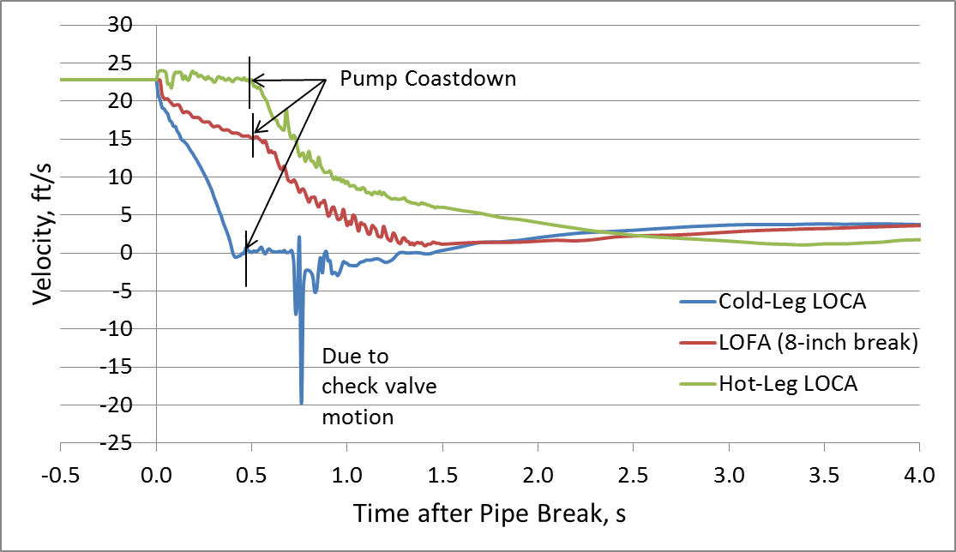
CD35 LOF and LOC Accidents Coolant Channel 23 Flow Velocity
13
TRTR Meeting – September 23-26, 2013
University of Missouri (MURR); St Louis, MO

Slide 14
LOF and LOC Accidents Using RELAP Peak Fuel Temperatures
14
Accident | HEU Core at 10 MW¹ | LEU Core at 12 MW² | Temperature Delta³
LOCA – Cold Leg | 342 °F | 347 °F | +5 °F
LOCA – Hot Leg | 254 °F | 310 °F | +56 °F
LOFA | 273 °F | 323 °F | +50 °F
Notes:
Core inlet water temperature set at LSSS of 155 °F.
Core inlet water temperature set at LSSS of 145 °F.
Increase in temperatures is a result of a 20% increase in power and lower fuel plate heat conductance.
Boron
TRTR Meeting – September 23-26, 2013
University of Missouri (MURR); St Louis, MO

Slide 15
Fuel Conversion affect on Beryllium Lifetime
15
Beryllium is replaced about every 8 years (~26,000 MWD) with current operating schedule (151 Hrs/wk) using HEU fuel at 10 MW
Fuel conversion to LEU fuel at 12 MW will alter thermal heating and swelling-induced stresses
MCNP analyses indicate an increase in the average gas concentration in the peak region from 1,530 ppm to 1,690 ppm (10.5 % greater)
MCNP analyses indicate a decrease in the average heating rate in the peak region from 4.65 w/cm³ to 3.63 w/cm³ (24 % less)
Based on this information, what is the overall affect? Will work with ATR & HFIR to better estimate it
TRTR Meeting – September 23-26, 2013
University of Missouri (MURR); St Louis, MO

Slide 16
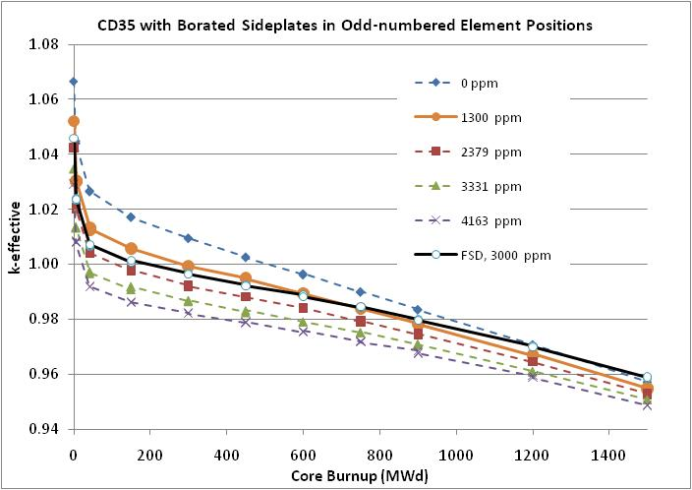
CD35 Transition Core – Borated Side Plates
16
TRTR Meeting – September 23-26, 2013
University of Missouri (MURR); St Louis, MO

Slide 17
Transition LEU Core CD35 - Fuel Cycle
17
Weekly LEU Cores | Core Elements (Boron/Standard) | Boron Side Plate LEU Fuel Elements | Standard Side Plate LEU Fuel Elements | BOC Core MWDs
C1 → C14 | 6/2 | 12 | 8 | 0 - 435
C15 → C27 | 4/4 | 12 | 16 | 340 - 640
C28 → C49 | 2/6 | 12 | 22 | 514 - 720
End of Transition Fuel Cycle—Normal LEU Fuel Cycle
C50 + | 0/8 | 0 | 32 | 632 Ave.
Boron side plate fuel elements contain 1300 ppm (0.13%) of B-10.
MURR will average retiring two fuel elements at 180 MWd burnup due to reactivity limitations and adding two new elements eleven times per year.
Boron
TRTR Meeting – September 23-26, 2013
University of Missouri (MURR); St Louis, MO
Notes:
Based on 1300 ppm B in side plates: Cycle phases: 14 weeks, 13, 22. End 1st year have needed mixed burnup in LEU standard fuel element fuel cycle.
MURR could use any where from ~1300 ppm upto ~2400 ppm in the side plates and make it work. Using 2400 ppm B in side plates would still require 12 transition elements for the transition cycle—but longer to get the same burnup in Transition elements or retire them with less burnup.

Slide 18
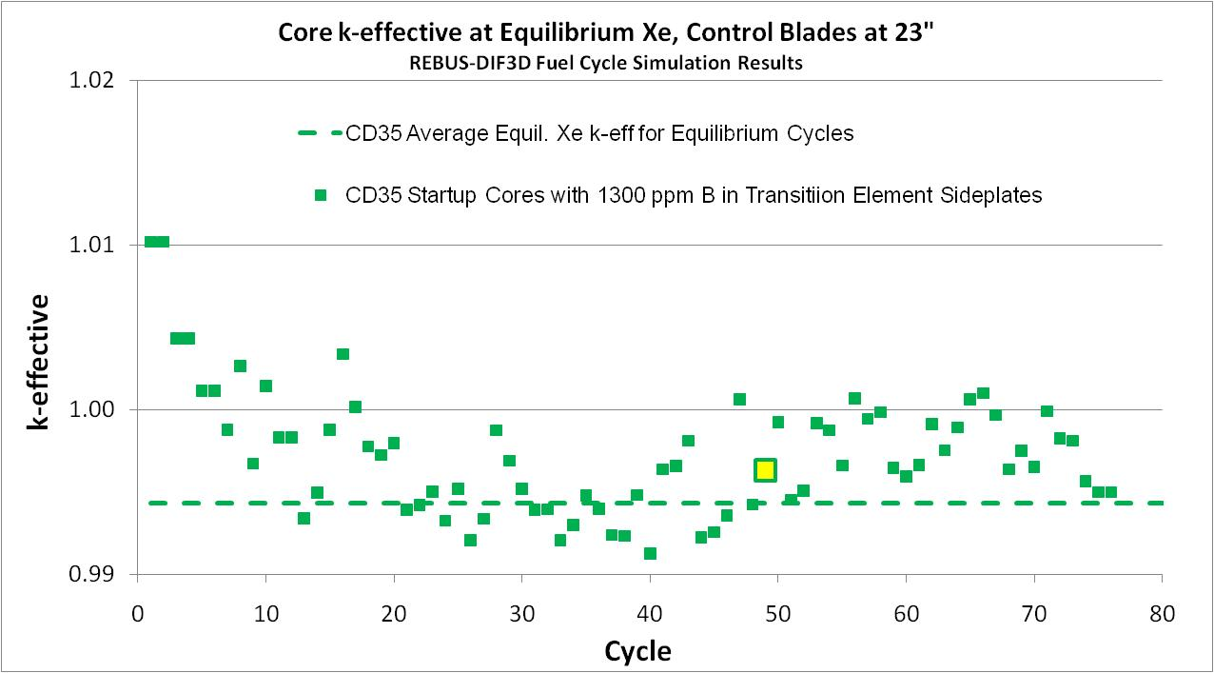
18
Potential Transition Fuel Cycle Cores Compared to the Intended Routine Cycle
Last cycle for transition elements: 49
Average k_{eff} for equilibrium cycles = 0.99436
Average k_{eff} for startup cycles 15-49 = 0.99534
TRTR Meeting – September 23-26, 2013
University of Missouri (MURR); St Louis, MO
Notes:
What is indicated is equalibrium Xe keff with control blades 23” withdrawn, which only 3” inserted—our typical equilibrium position during each weekly run time.
Dashed line is steady state CD35 fuel cycle with average fuel element half burned up and no transition elements
Green boxes are for each weekly equilibrium Keff, with a mix of transition and regular CD35 elements in the core during the first 49

Slide 19
Summary of Recent Accomplishments
19
Completed alternate LEU fuel element design CD35 for thicker clad and thicker plates than feasibility study design.
Completed steady-state safety basis for CD35 LEU core at 12 MW:
J. Stillman, et al., “Technical Basis in Support of the Conversion of the University of Missouri Research Reactor (MURR) Core from Highly-Enriched to Low-Enriched Uranium – Core Neutron Physics,” September 2012
E. E. Feldman, et al., “Technical Basis in Support of the Conversion of the University of Missouri Research Reactor (MURR) Core from Highly-Enriched to Low-Enriched Uranium – Steady-State Thermal-Hydraulic Analysis,” January 2013
L. Foyto, et al., “Draft Chapter 4, Reactor Description, Safety Analysis Report, Highly-Enriched to Low-Enriched Uranium Conversions,” January 2013
TRTR Meeting – September 23-26, 2013
University of Missouri (MURR); St Louis, MO

Slide 20
Summary of Recent Accomplishments
20
Increasing formality of information exchange with FD Pillar:
J. Stillman, et al., “Conceptual Design Parameters for MURR LEU U-Mo Fuel Conversion Design Demonstration Experiment,” September 2012
J. Stillman, et al., “Irradiation Experiment Conceptual Design Parameters for MURR LEU U-Mo Fuel Conversion,” March 2013
Rev 1 completed (June) to describe impacts of tolerances & uncertainties
Completing Phase 1 of Transient and Accident Analyses for LEU core CD35 as required by Chapter 13 of the LEU Conversion SAR – MCNP
Completing Phase 1 of Ancillary Analyses
Effect of LEU at 12 MW on Beryllium Lifetime
Transition Element Design and Strategy for CD35 LEU Fuel Cycle
TRTR Meeting – September 23-26, 2013
University of Missouri (MURR); St Louis, MO

Slide 21
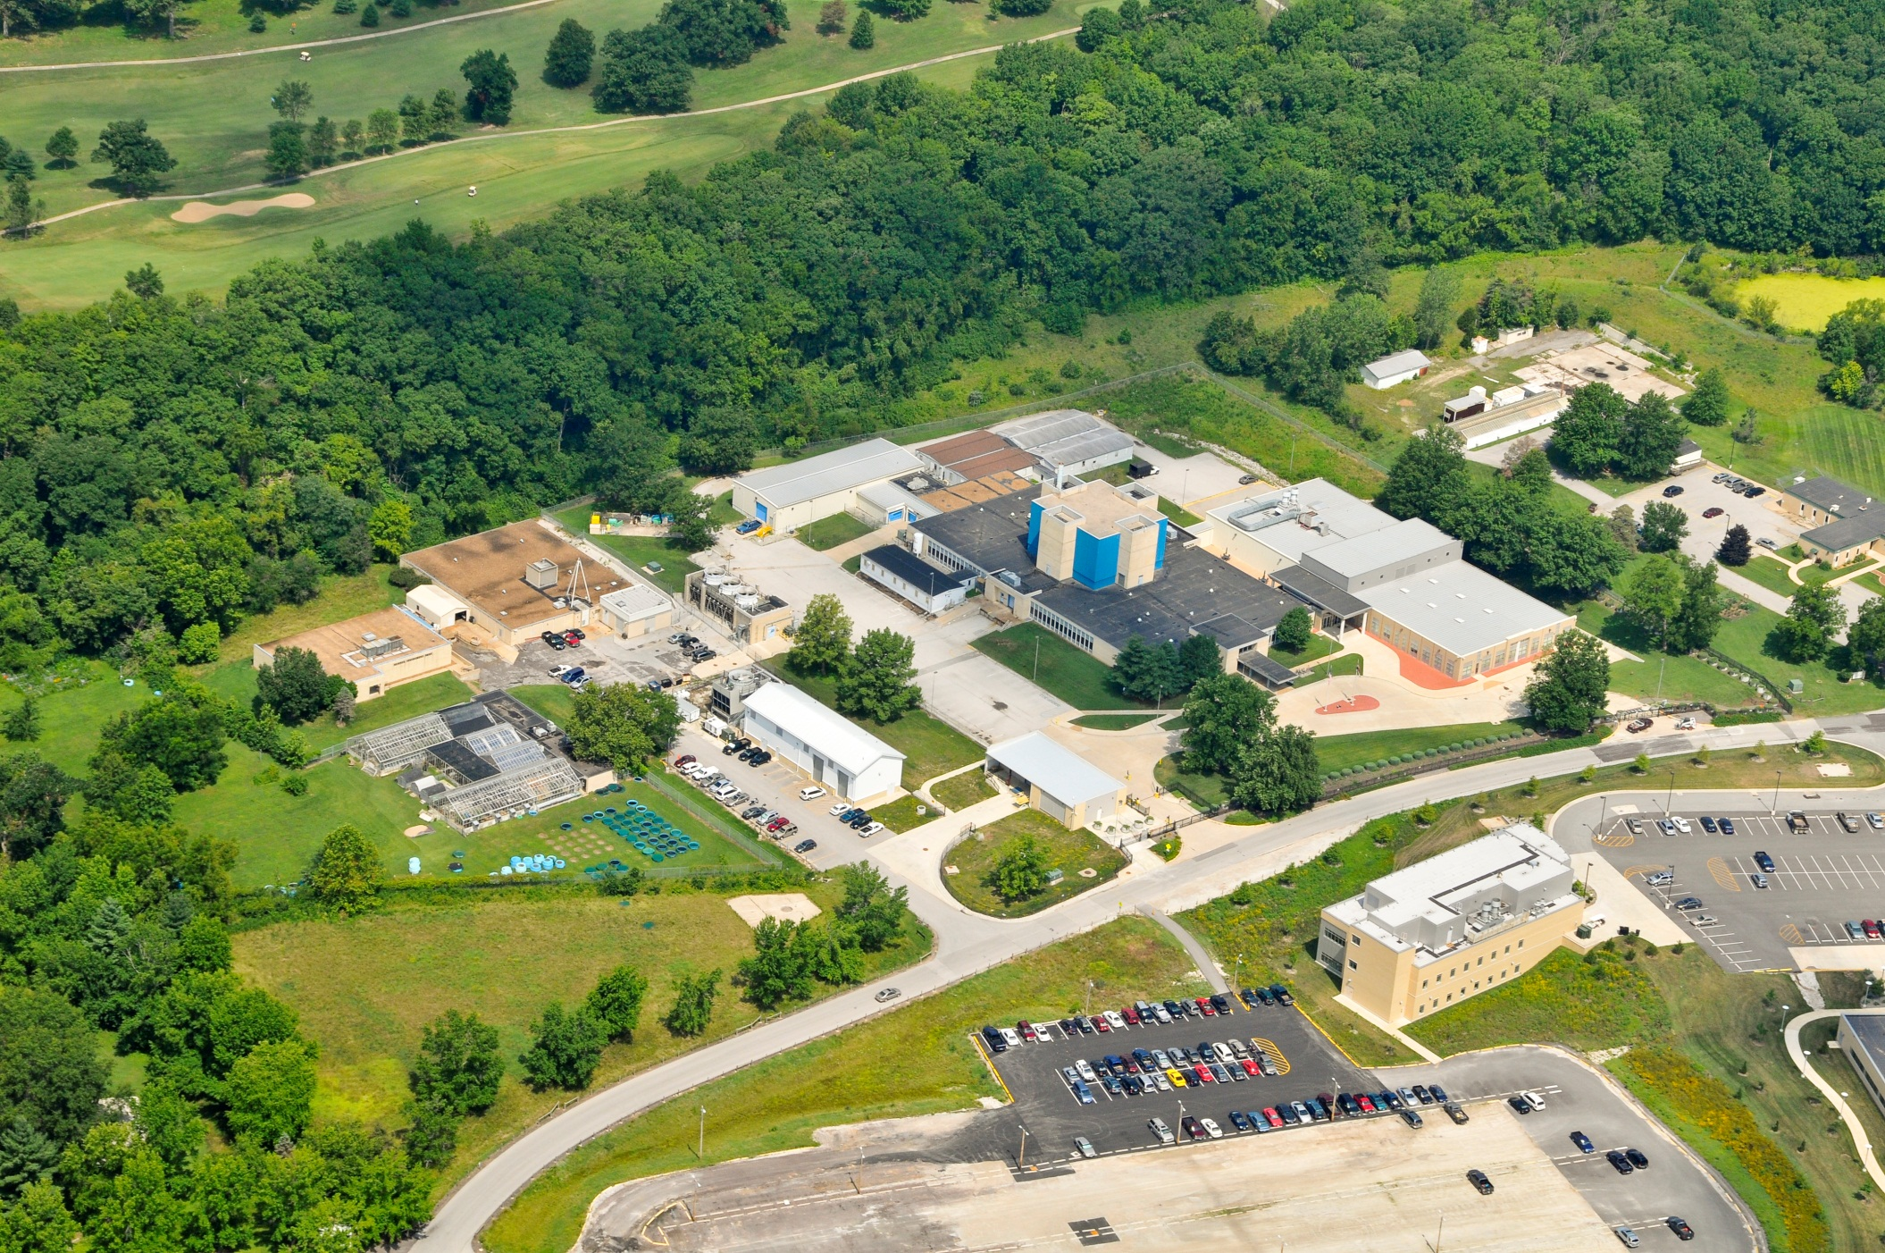
Thank You For You Attention,
Any Questions???
TRTR Meeting – September 23-26, 2013
University of Missouri (MURR); St Louis, MO

