Slide 1

The Impact of the HEU to LEU Fuel Conversion on the Lifetime and Efficacy of Beryllium:
The primary neutron reflector at high-performance research and test reactors
N.J. Peters, J.C. McKibben and L. P. Foyto
University of Missouri Research Reactor Facility
1513 Research Park Drive, Columbia, Missouri 65211 – U.S.A

Slide 2
Facility Overview
Location: University of Missouri main campus in Columbia, Missouri, USA [200 km West of St Louis]
Purpose: Multi-disciplinary research and education facility also providing a broad range of analytical and irradiation services to the research community and the commercial sector.
History:
First achieved criticality on October 13, 1966
Initially licensed at 5 MW
Uprated in power to 10 MW in 1974
Started ≥150 hours/week operation in September 1977
Submitted relicensing application in 2006 to the NRC

Slide 3

MURR Core Basic Reactor Parameters
MURR® is a pressurized, heterogeneous, reflected, open pool-type, which is light-water moderated and cooled
Maximum power – 10 MW_{th}
Peak flux in center test hole – 6.0E14 n/cm²-s
Core – 8 fuel assemblies (775 grams of U-235/assembly)
Excess reactivity control blades – 5 total: 4 BORAL® shim-safety, 1 SS regulating
Primary Reflector – beryllium*
Forced primary coolant flow rate – 3,750 gpm (237 lps)
Forced pool coolant flow rate – 1,200 gpm (76 lps)
Primary coolant temps – 120 °F (49 °C) inlet, 136 °F (58 °C) outlet
Primary coolant system pressure – 85 psia (586 kPa)
Pool coolant temps – 100 °F (38 °C) inlet, 106 °F (41 °C) outlet
Beamports – three 4-inch (10 cm), three 6-inch (15 cm)

Slide 4
Beryllium as a Primary Neutron Reflector at Research Reactors
Advantageous qualities of beryllium:
Has one of the highest atom number densities (i.e., a relatively large scattering cross-section).
A very small neutron absorption cross-section.
Though not as efficient, also a neutron multiplier due to its small ⁹Be (n_{f}, 2n) 2 ⁴He and ⁹Be (γ, n) 2 ⁴He cross-sections which increases core excess reactivity.
Usage of beryllium as neutron reflector:
ATR (INL)– 200MW
HFIR (ORNL)– 100MW
MURR (Missouri University) –10 MW
Works well for high power density Research Reactors (e.g. MURR)

Slide 5
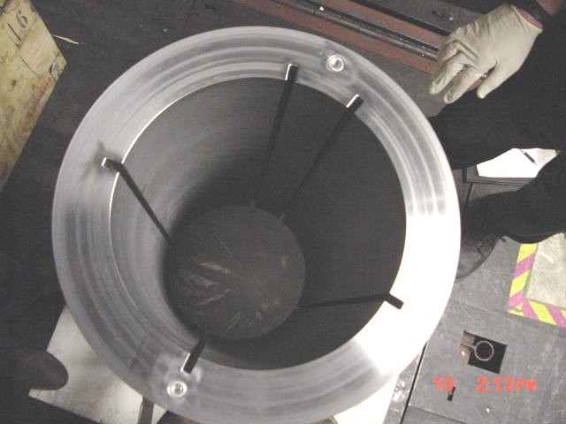
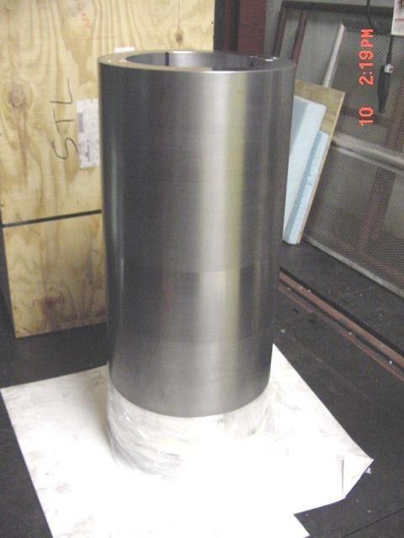
The MURR Beryllium Reflector
Geometry: cylindrical sleeve located around the outer reactor pressure vessel at the height that contains the reactor core
Material: S-200FH grade
Height: 37 inches (94 cm)
Outer diameter: 19 inches (48.3 cm)
Sleeve thickness: 2.71 inches (6.9 cm)
Present replacement schedule for MURR HEU core: 8 years of full-power operation or 26000 MWD at 10MW
  Based on observed stress-fracture failure of beryllium in 1981
  Expected replacement schedule for proposed LEU-CD35 conversion core: ????

Slide 6
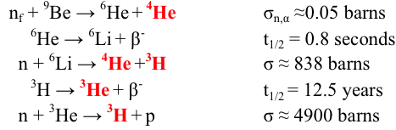
Limits on the Beryllium Lifetime at Research Reactors
Routine replacement of beryllium due to radiation induced stress-fracture failure:
  Swelling stress from gas production
  Thermal stress from radiation (gamma) energy deposition
Fuel conversion from HEU (UAl_{x} dispersion) to LEU (U-10Mo monolithic)
  In accordance with the mission of the Global Threat Reduction Initiative (GTRI), the current capabilities and performance of research and test reactors must be maintained after conversion
Very limited studies and measurements available!
No previous studies available!

Slide 7
The Importance and Purpose/Intent of Investigating Beryllium Lifetime Limits
  Beryllium reflectors are specifically designed and fabricated to provide a critical core and desired power/flux distributions
  Beryllium may be a part of the actual core structural component (HFIR, ATR) or can affect operation of other core component (MURR), such that failure can compromise normal operation
Until now, the development of a systematic approach to study the beryllium performance and predict the total stress as a function of megawatt days, has been lacking
Specifically, the goal is to predict if there is a change in the stress vs. MWD curve, and performance, on conversion of MURR from 10MW HEU to 12MW LEU, using MCNP-coupled-ORIGEN depletion models

Slide 8
Computational Methodology for Beryllium Depletion Models
MONTEBURNS 2.0
1-group Flux
1-group cross-section
MCNP5
Detailed Fluxes &
Reaction Rates
ORIGEN 2.2
Mass
Activity
Heatload
Burnup
New Material definition
MONTEBURNS 2.0 – Time-dependent, cyclic, stepwise, MCNP-coupled-ORIGEN nuclear burn-up code system (LANL)

Slide 9
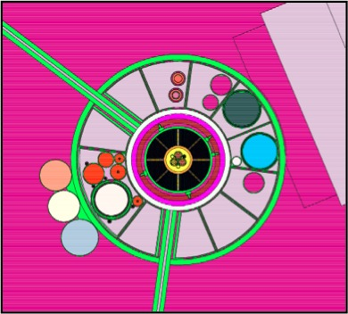
MCNP5 MURR Core HEU/LEU-CD35 Model
MURR current HEU and proposed LEU-CD35 ex-core configuration is expected to have identical geometry
HEU core:
  Fuel matrix: UAl_{x}, 24-plate
  Density = 3.7g/cc
  Typical mixed-fuel core configuration: (640MWD) at 10MW
  U mass per core = 6.2Kg
LEU-CD35 core:
  Fuel matrix: U-10Mo, 23-plate
  Density = 15.7g/cc
  Similar mixed-fuel core configuration: (765MWD) at 12 MW
  U mass per core = 14.0Kg
Discretized Beryllium Sleeve

Slide 10
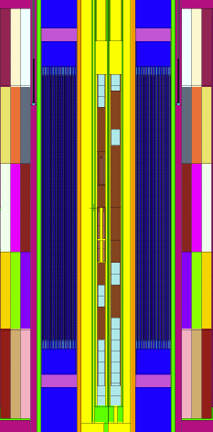
Discretization of the Beryllium Reflector MCNP5 Model
Axial section 1
Discretized Beryllium Sleeve
Axial section 2
Axial section 3
(peak flux zone)
Inner core
region
15 individual depletion zones (rings): 3 radial and 5 axial sections
Axial section 4
Axial section 5

Slide 11
Predicted Fast Flux Profile for MURR HEU Core Beryllium Reflector
Axial section 1
Current beryllium Peak Fast Flux
(> 0.1MeV) = 9.40 x 10¹³ n•cm⁻²s⁻¹
MURR LEU-CD35 Core (> 0.1MeV) fast flux =1.01 x 10¹⁴ n•cm⁻²s⁻¹
Axial section 2
Axial section 3
(peak flux zone)
Core Centerline
Axial section 4
Axial section 5

Slide 12
Gas Production Predictions from Models
Predicted Peak ⁴He, ³He, ⁶Li and ³H concentration in beryllium after 8 years of full-power LEU operation
Predicted Peak ⁴He, ³He, ⁶Li and ³H concentration in beryllium after 8 years of full-power HEU operation
~11% larger gas + ⁶Li production in beryllium from LEU-CD35 Core

Slide 13
Beryllium Gas Production Profiles for Swelling Analysis in for HEU and LEU Core
Total Gas production in beryllium for LEU Core at 8 yrs
Total gas production in beryllium for HEU core at 8 yrs

Slide 14
Total Heating Profiles in Beryllium for Thermal Stress Analysis: HEU Vs. LEU Core
Total heating rate in beryllium for LEU Core
Total heating rate in beryllium for HEU Core

Slide 15
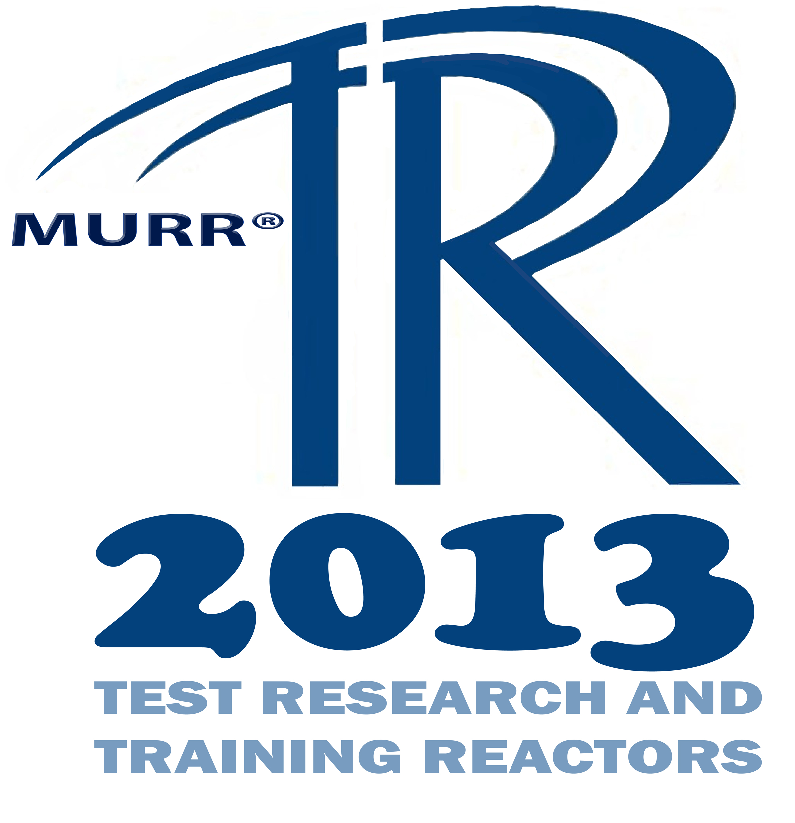
Preliminary Estimation of LEU-CD35 Beryllium Lifetime at MURR
Internuclear Company calculated a maximum thermal stress of 16,690psi as compared to the assumed beryllium’s yield stress of 27,000psi for HEU at 10MW
  Gas swelling stress HEU = beryllium yield stress - maximum thermal stress (10,310 psi)
  Thermal stress proportional heating difference between surfaces. Ratio between HEU and LEU-CD35 implies LEU-CD35 at 12MW thermal stress is reduced to 13,320 psi
  Consequently, LEU-CD35 at 12MW swelling stress is increased to 13,680 psi
Using a conversion factor of 10.25psi/ppm and the LEU-CD35 gas production rate of 139ppm/yr, lifetime for beryllium extended from 8 years to 9.6 years
Caveats:
Assumes that the beryllium yield stress is constant (i.e., unaffected during operation
The swelling behavior as a function of megawatts is not well known for beryllium
No measurements to benchmark model predictions
Collaboration with HFIR and ATR for more analysis of data on beryllium

Slide 16
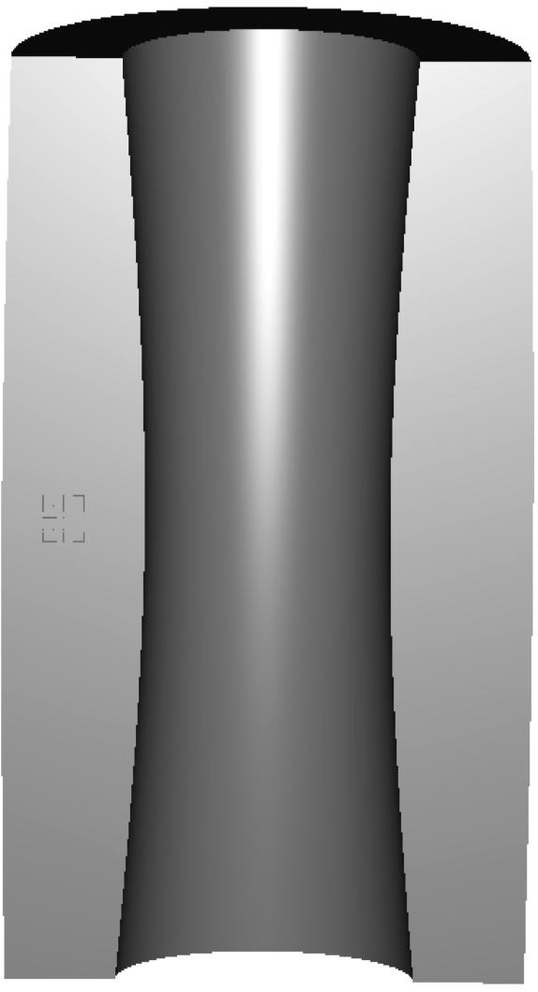
Performance Degradation in Beryllium HEU and LEU Core: Excess Reactivity Loss
Core Excess Reactivity loss is due to:
Buildup of the neutron poisons ⁶Li and ³He
  absorption cross-sections = ~900 and 4900 barns
  ⁶Li reaches equilibrium value in ~1 year
  ³He constant increase with MWDs; small concentration <1ppm at 26000 MWD
Swelling due to steady helium + tritium buildup decreases the beryllium macroscopic scattering cross-section
Region of greatest expected swelling
Exaggeration of MURR beryllium swelling

Slide 17
Excess Reactivity Loss Vs. Time Curve for HEU vs. LEU-CD35
  Includes an arbitrury beryllium swelling rate = 0.09% per year
  LEU has ~10% greater loss in reactivity at 26000 MWDs

Slide 18
Summary and Future Works
MCNP-coupled ORIGEN depletion simulations were used to predict the gas production and heating profiles in beryllium neutron reflector to study stress increase that can lead to fracture failure for the HEU and LEU-CD35 MURR core configuration.
It is shown that for the HEU core, there is more energy deposited and less gas produced in the beryllium which may correspond to greater thermal stress and lower swelling stress, as compared to the LEU core.
Preliminary estimation for MURR’s beryllium shows a 1½ years increase in beryllium lifetime using the LEU-CD35 core as compared to the HEU core.
Neutron poison buildup and swelling appears to be responsible an increase lost (~10%) of excess reactivity in LEU-CD35 Core at 8 years of operation.
Increasing the data based for the impact of irradiating beryllium at research reactors is planned for future works:
  Benchmarking measurements are being done for the MURR beryllium
  Analyzing beryllium irradiation data from HFIR and ATR

Slide 19
Thank you
Questions ?

