Slide 1
Analysis of Reactivity Insertion Accidents for the NIST Research Reactor Before and After Fuel Conversion
J.S. Baek, A. Cuadra, L-Y. Cheng, A.L. Hanson, N.R. Brown, and D.J. Diamond,
Nuclear Science & Technology Department
Brookhaven National Laboratory
Presented at
Test, Research, and Training Reactors
2013 Annual Conference
September 23-26, 2013

Slide 2
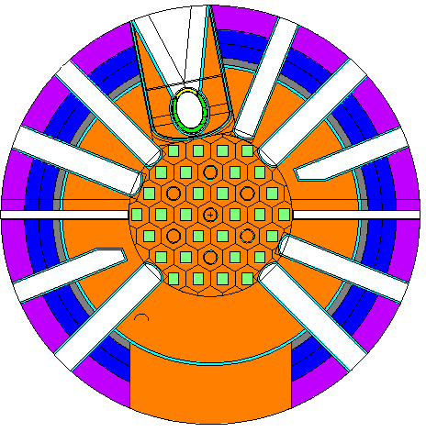
Outlines
Background
NBSR
RELAP5 Model
Thermal-Hydraulic Analysis
Summary and Conclusions

Slide 3
Background
A plan is being developed for the conversion of the NIST (National Institute of Standards and Technology) research reactor (NBSR) from high-enriched uranium (HEU) fuel to low-enriched uranium (LEU) fuel.
  Fuel conversion
    HEU (93% ²³⁵U): U₃O₈ mixed with aluminum powder
    LEU (19.75% ²³⁵U): A foil of U10Mo (uranium alloy with 10% molybdenum by weight)
Need of safety analysis works for U.S. NRC conversion license of NBSR
RELAP5 model has been developed to perform safety analysis for the NBSR.
  NBSR with LEU fuel and HEU fuel

Slide 4
Background (cont.)
Presenting the results of safety analysis of reactivity insertion accidents
  Control rod withdrawal startup accident
  Maximum reactivity insertion accident
Post-processing of simulation results to evaluate CHFR and OFIR
  A FORTRAN program was developed.
  Sudo-Kaminaga correlations for CHFR
  Saha-Zuber Criteria for OFIR
4

Slide 5
NBSR
NBSR: National Bureau of Standard Reactor
  NBS: Old name of NIST
  Providing world-class capabilities in cold-neutron research
    Materials science, chemistry, biology, neutron standards and dosimetry, nuclear physics, etc.
  20 MW power
  Heavy water (D₂O) moderated and cooled
  Inner and outer plena
    A double plenum to provide optimized cooling to the core
  MTR Plate-type enriched fuel elements
    Two fuel sections with an unfueled gap in the middle to reduce the fast neutron background in the neutron beam, resulting in the thermal neutron reaching a peak in the center of the gap
    17 plates in each section
5

Slide 6
NBSR (cont.)
Cut-away view of NBSR core
Al reactor vessel (3)
18 cm gap (5) between upper and lower fuel sections (18)
Semaphore-type Cd shim arms (2)
Cold neutron source (15)
6

Slide 7
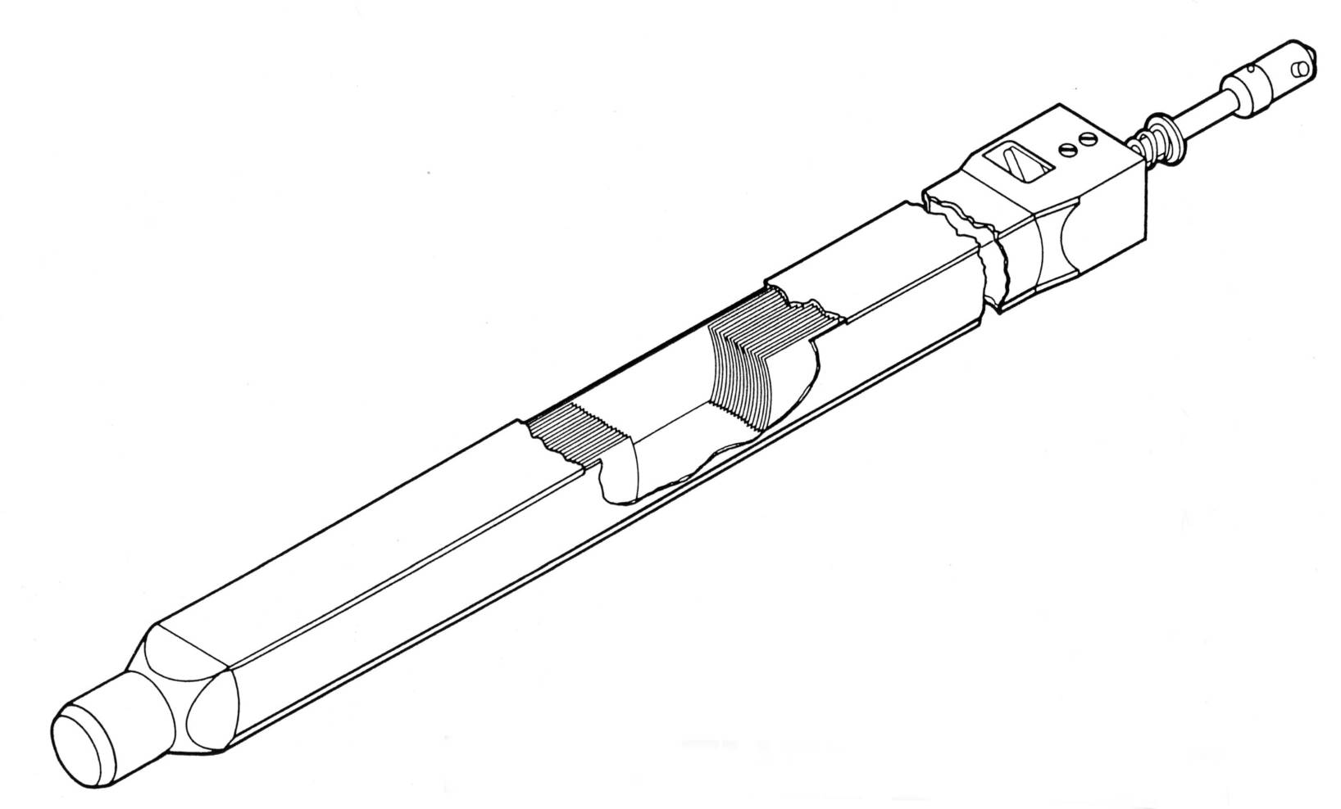
NBSR (cont.)
Two fuel sections
17 fuel plates in each section
  0.51 mm thickness
  6 cm width
  28 cm fuel plate length
18 cm gap between two fuel sections
NBSR Fuel Elements
7

Slide 8
RELAP5 NBSR Model
Detailed NBSR vessel and core
Primary piping from vessel outlet to inlet
Primary and shutdown pumps
Heat exchangers
Rectangular heat structure to represent the NBSR fuel plates
  30 fuel elements
    6 in inner plenum
    24 in outer plenum
Point kinetics with 14 precursors
  6 for fission product delayed neutrons
  8 for photoneutrons
No reactivity feedback is assumed (conservatively).
  Only shim arm reactivity is considered.
8

Slide 9
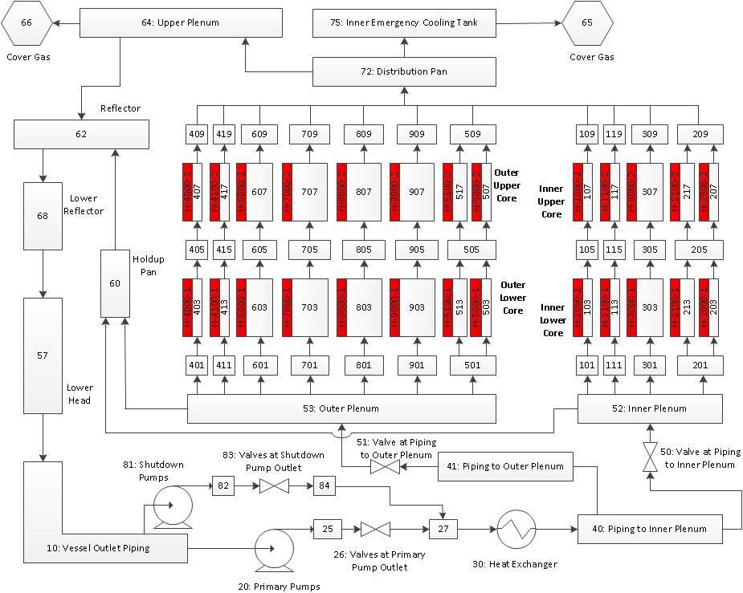
RELAP5 NBSR Model (cont.)

Slide 10
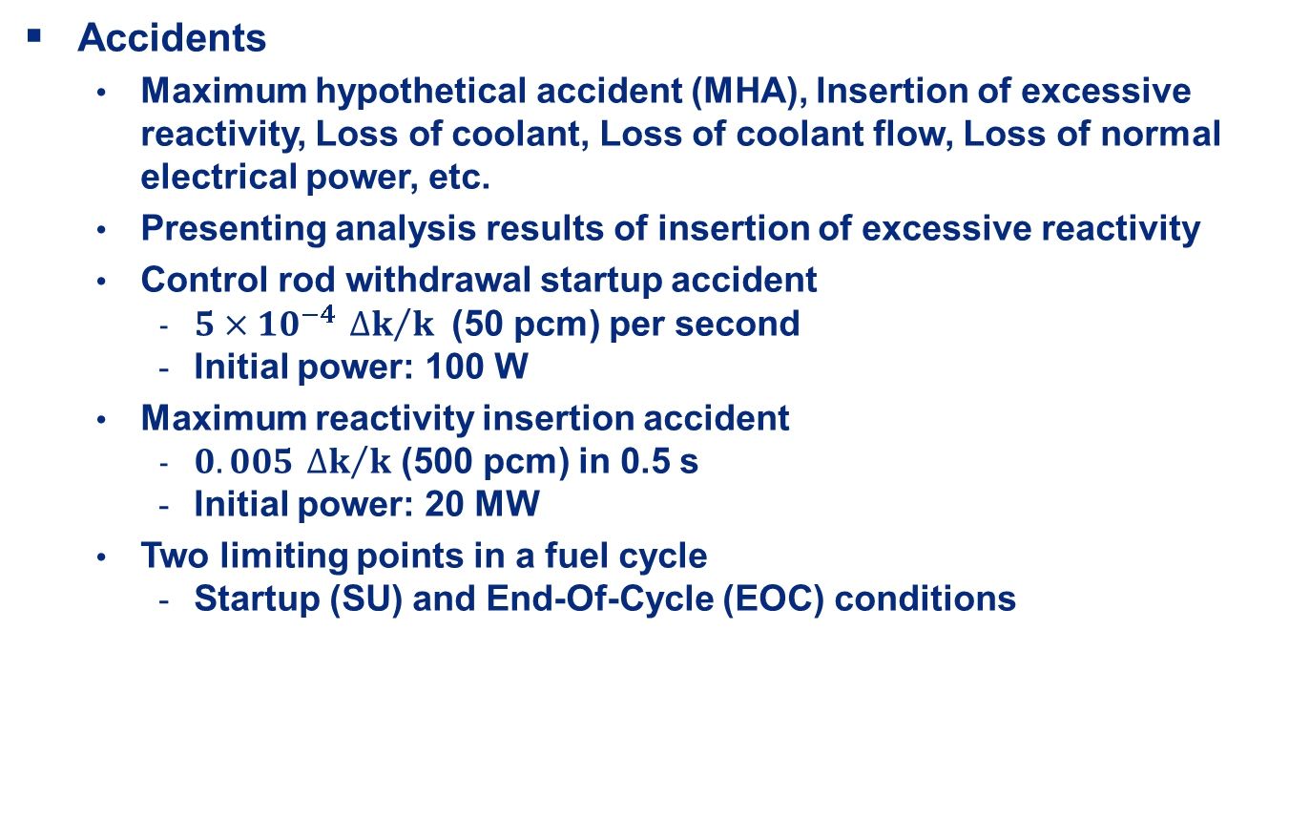
Thermal-Hydraulic Analysis
Accidents
  Maximum hypothetical accident (MHA), Insertion of excessive reactivity, Loss of coolant, Loss of coolant flow, Loss of normal electrical power, etc.
  Presenting analysis results of insertion of excessive reactivity
  Control rod withdrawal startup accident
    $5×{10}^{−4} {∆k}/k$ (50 pcm) per second
    Initial power: 100 W
  Maximum reactivity insertion accident
    $0.005 {∆k}/k$ (500 pcm) in 0.5 s
    Initial power: 20 MW
  Two limiting points in a fuel cycle
    Startup (SU) and End-Of-Cycle (EOC) conditions
10

Slide 11
Thermal-Hydraulic Analysis (cont.)
  Control rod withdrawal startup accident
  Power increases almost exponentially.
  Reactor trip at 26 MW
  Peak power
    40.2 MW with HEU at EOC
    37.6 MW with HEU at SU
    42.0 MW with LEU at EOC
    38.2 MW with LEU at SU
    Different negative reactivity insertion rate after reactor trip
11

Slide 12
Thermal-Hydraulic Analysis (cont.)
  Control rod withdrawal startup accident (cont.)
  Peak power
    Shim arms start dropping
      From 23°at SU
      From 41°(fully withdrawn) at EOC
12

Slide 13
Thermal-Hydraulic Analysis (cont.)
  Control rod withdrawal startup accident (cont.)
  Power increases more rapidly with LEU fuel
    Smaller delayed neutron fraction and shorter neutron lifetime
  Power increases faster at SU
    Shorter neutron lifetime as a result of shim arm presence
13

Slide 14
Thermal-Hydraulic Analysis (cont.)
  Control rod withdrawal startup accident (cont.)
  Cladding temperature
  PCT
    399 K with HEU at EOC
    397 K with HEU at SU
    402 K with LEU at EOC
    396 K with LEU at SU
  Small temperature rise
    100 K with LEU at EOC
14

Slide 15
Thermal-Hydraulic Analysis (cont.)
  Control rod withdrawal startup accident (cont.)
  Critical Heat Flux Ratio (CHFR)
    A post-processing
  Minimum CHFR
    2.15 with HEU at EOC
    2.19 with HEU at SU
    2.04 with LEU at EOC
    2.21 with LEU at SU
    Larger than 1.78 and 1.86 (probability greater than 99.9%)
    BNL performed a statistical analysis with a large size of sampling to quantify uncertainties of key parameters of CHF.
15

Slide 16
Thermal-Hydraulic Analysis (cont.)
  Control rod withdrawal startup accident (cont.)
  Onset-of-Flow Instability Ratio (OFIR)
    A post-processing
  Minimum OFIR
    3.63 with HEU at EOC
    3.49 with HEU at SU
    3.54 with LEU at EOC
    3.50 with LEU at SU
    Much larger than 1.58 and 1.73 (probability greater than 99.9%)
    BNL performed a statistical analysis with a large size of sampling to quantify uncertainties of key parameters of OFI.
16

Slide 17
Thermal-Hydraulic Analysis (cont.)
  Maximum reactivity insertion accident
  Reactor trip at 26 MW
  Peak Power
    Highest peak power of 34 MW with LEU at EOC
  Cladding Temperature
    Highest PCT of 397 K (ΔT = 27 K) with LEU at EOC
17

Slide 18
Thermal-Hydraulic Analysis (cont.)
  Maximum reactivity insertion accident (cont.)
  Minimum CHFR
    Smallest minimum CHFR of 2.25 with LEU at EOC
  Minimum OFIR
    Smallest minimum OFIR of 3.25 with HEU at SU
18

Slide 19
Summary and Conclusions
A detailed RELAP5 model has been developed to analyze the NIST research reactor (NBSR) with fuel conversion from HEU to LEU.
Insertion of excessive reactivity accidents have been analyzed.
  Control rod withdrawal startup and maximum reactivity insertion accidents.
Two limiting points (SU and EOC) in a fuel cycle have been considered.
A post-processing has been performed to evaluate CHFR and OFIR.
Reactor power, peak cladding temperature, minimum CHFR, and minimum OFIR have been investigated.
  All PCTs are lower than blister temperature.
  All minimum CHFRs and OFIRs are very high.
19

Slide 20
Summary and Conclusions (cont.)
Conclusions
  The integrity of the NBSR fuel elements is preserved in all cases with both LEU and HEU fuels.
  NBSR still has a large safety margin with LEU core.
20

