Slide 1
IAEA Activities in Support of Operation and Maintenance of Research reactors
Ram Sharma
Acting Section Head, Research Reactor Section
NEFW, Department of Nuclear Energy, IAEA
Test, Research and Training Reactors Annual Conference
October 28 – November 1, 2018;
Newport Marriott, Newport, Rhode Island

Slide 2

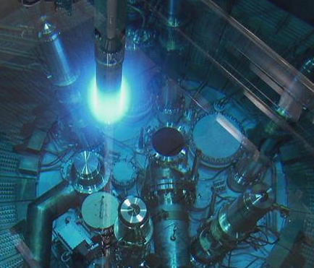
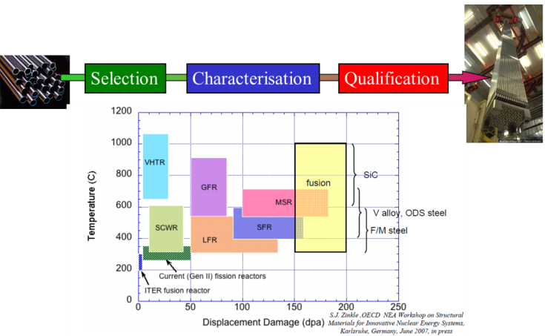
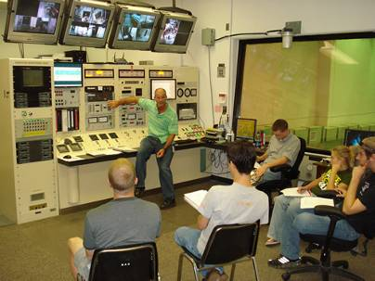
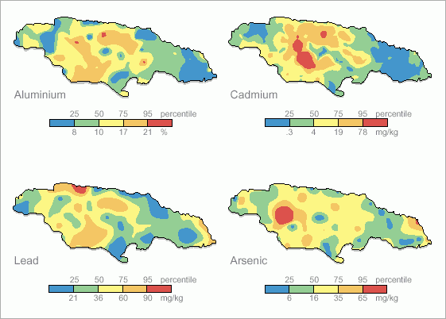
RRs in everyday life
Silicon doping for electronic components
Radioisotopes for medical, industrial and agricultural applications
Non-destructive Examination
(e.g. neutron imaging)
Gemstones coloration
Education & training in nuclear
science & technology
Support to Nuclear Power Industry (Fuel qualification, NPP life extension, material testing)
Research in many Scientific Disciplines
(e.g. geological & environmental studies)

Slide 3
IAEA RRDB Overview
21 Sep 2018
Status | Developed Countries | Developing Countries | All Countries
Planned | 2 | 11 | 13
Under construction | 4 | 5 | 9
Operational | 140 | 86 | 226
Temporary shutdown | 8 | 5 | 13
Extended shutdown | 5 | 8 | 13
Permanent shutdown | 42 | 14 | 56
Under decommissioning | 63 | 4 | 67
Decommissioned | 413 | 29 | 443
Total | 677 | 163 | 840
818 built

Slide 4
IAEA RRDB Overview
Numbers of operational research reactors
21 Sep 2018

Slide 5
IAEA RRDB Overview
Ageing status
21 Sep 2018
  60% of operating RRs are over 40 years old.
  43 % of operating RRs are more than 50 years old.

Slide 6
IAEA RRDB Overview
Ageing status
21 Sep 2018
  60% of operating RRs are over 40 years old.
  43 % of operating RRs are more than 50 years old.

Slide 7
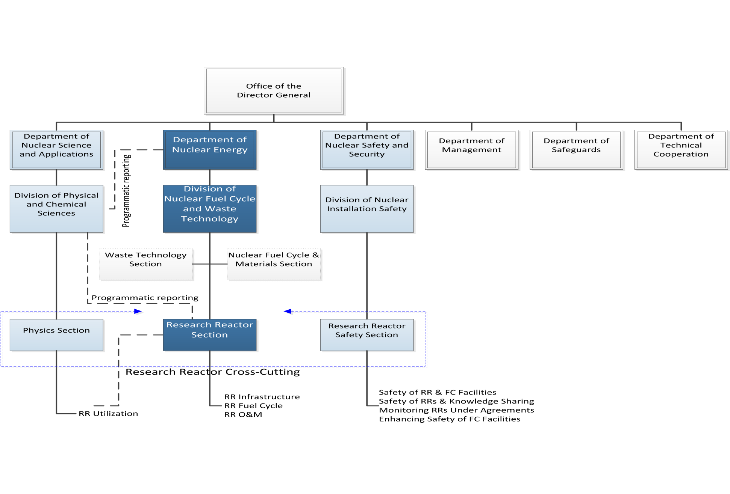
Cross-cutting Activity on RRs Coordination Group

Slide 8






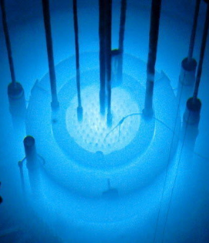

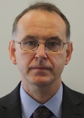
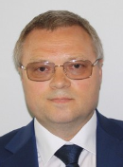






R. Sharma
NAPC-PS
R. Thottakkara
N. Hakimy-Sadiq
K. Milosovicova
Vacant Position
N. Pessoa Barradas
NEFW
Research Reactor Section
F. Marshall
A. Sitnikov
9 (2) P-staff
3 G-staff
2 SSAs
I. P.
Swainson
P. Chakrov
T. Hanlon
Y. G. Cho
N. Peld
U. Salikhbaev
A. Zhukova
Vacant Position

Slide 9
RR sub-programme (1.4.2.)
The sustainability of RRs life-cycle is an issue of major concern, also considering that the majority of the existing RRs have reached 40 years of operation MS are increasingly seeking Agency's assistance in addressing the main challenges related to RR sustainable operation and effective utilization as well as in building new and accessing existing RRs for developing their national nuclear programmes and strategies, including for development of human capital
Objectives
To support Member States in ensuring sustainable operation and effective utilization of existing research reactors on long term basis with enhanced availability and reliability
To support Member States in nuclear capacity building based on the use of and access to RRs
To support Member States in planning and implementing new research reactor projects, including the development of their national infrastructure

Slide 10
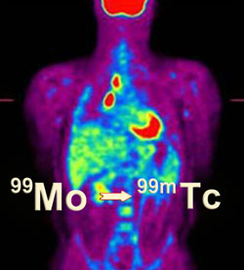
RR sub-programme (1.4.2.)
Project 1.4.2.001 Enhancement of utilization and applications of research reactors
RRs remain indispensable in the provision of radioisotopes for medicine and industry, neutron beams for material research and non-destructive testing, analytical and irradiation services both for private and public sectors
Equally, the contribution of RRs to the education and training of the new generation of scientists and engineers in support of nuclear science and technology programmes remains a strategic role for their utilization
As the ageing RR fleet continues to decrease, the remaining and new facilities need to be efficiently utilized, well managed with the aim for sustainable long term operation
Objectives
To assist MS in enhancing RR utilization for many applications, such as isotope production, use of neutron beams, irradiation and analytical services, material characterization and testing consistent with RR features, nuclear education and training
To increase cooperation and resource sharing between different RR centres, promote and strengthen both regional and thematic networking, including interested Member States without RRs
To assist RR centres in development of user communities and industrial partnership for enhanced and sustainable RR utilization by offering products and services

Slide 11
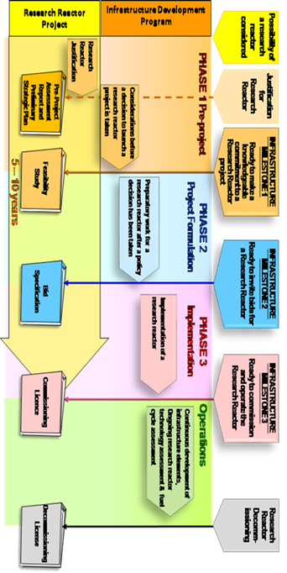
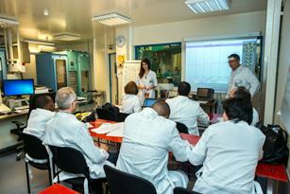
RR sub-programme (1.4.2.)
Project 1.4.2.002 Research reactor infrastructure development and capacity building
Several Member States (MS) have started planning or building their first research reactor as a key national facility for the development of their nuclear science and technology programmes, including nuclear power
However, the introduction of the first research reactor in a country requires the establishment of an adequate national infrastructure which covers a wide range of technical areas to ensure that national and international commitments and obligations, particularly regarding safety, security, safeguards and emergency preparedness, are met during the construction, operation and decommissioning phases
Several MS developing nuclear science and technology programmes, including nuclear power programmes, are also seeking opportunities to access RR to achieve their national capacity building objectives
Objectives
To assist MS in planning and implementing new RR projects, including the assessment and development of their national nuclear infrastructure
To assist Member States in building and/or preserving national nuclear capacity, including human resources development, through the use of research reactors and procurement of specific equipment and services
To increase access to research reactors for all MS developing nuclear science and technology programmes, including nuclear power

Slide 12
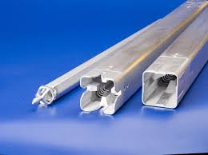
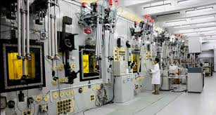
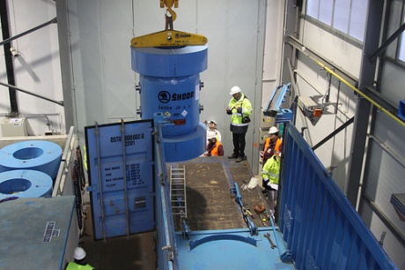
RR sub-programme (1.4.2.)
Project 1.4.2.003 Addressing research reactor fuel cycle issues
Assurance of new fuel supply is a concern for research reactors (RRs); cooperation between RR organizations and Member States (MS) can be fostered to leverage supply options
Back-end options for the RR nuclear fuel cycle need to consider non-proliferation, national policy, economics, and environmental concerns as well as technical issues
The continued safe, reliable, and economic handling, management and storage of RR Spent Nuclear Fuel (SNF) of all types is a serious issue for most MS with RRs
Ongoing, international programmes seek to convert RR fuel and targets from High Enriched Uranium (HEU) to Low Enriched Uranium (LEU). Many RRs have been converted to LEU fuel and targets, with significant quantities of fresh and spent HEU repatriated to the country of origin. Development and qualification of very high density fuels are necessary to convert the remaining RRs from HEU to LEU
Objectives
To assist MS in strengthening the capability to deal with all fuel cycle issues, including fuel supply, development, fabrication and qualification of new fuels, vulnerabilities related to SNF management and the back end of the fuel cycle
To assist MS, upon request, with the conversion of research reactors and targets for radioisotope production from HEU to LEU and repatriation of SNF to its country of origin

Slide 13
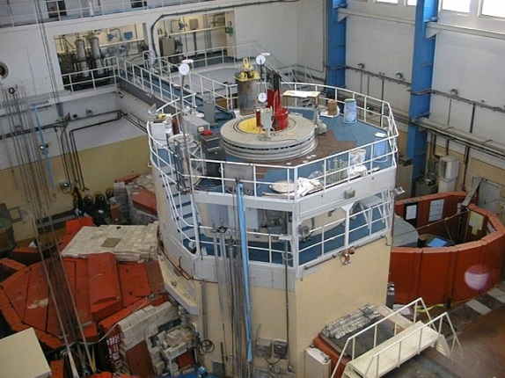
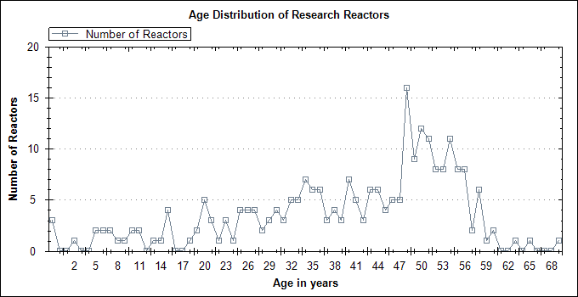
RR sub-programme (1.4.2.)
Project 1.4.2.004 Research reactor operation and maintenance
Approximately 60% of the operating research reactors (RR) in the world are more than 40 years old. Although the life of such facilities could reach 60 years and beyond, it is of paramount importance that adequate life management programmes (ageing and refurbishment/upgradation programmes) are established well in time
Adequate operation and maintenance (O&M) plans, as well as management system, need also to be in place to ensure optimization of operational performances of existing research reactors
Considering the general trend of funding reduction for such facilities and limited succession planning, development and implementation of sound O&M as well as life management programmes are vital to ensure for these facilities a cost-effective completion of their assigned missions
Another very relevant issue is related to the fact that two thirds of the research reactors ever built, are currently in permanent shut-down state and need to be decommissioned
Objectives
To assist Member States in developing and implementing operation and maintenance plans to improve facility's operational performances and in establishing integrated management systems
To assist Member States in developing and implementing ageing management and renovation/upgradation programmes for facility's life management
To contribute to IAEA cross-cutting activities on research reactors' decommissioning

Slide 14
RRS (O&M) - Major Activities
Technical Meetings
Training Workshops
Peer Review and Expert Missions
Coordinated Research Projects
RR Information Resources
Publications

Slide 15
Technical Meetings
Ageing Management, Refurbishment and Modernization of research reactors (every two-years, held in Oct 2017, next in 2019)
Upgrades to Digital Instrumentation and Control Systems for Research Reactors (every two years, held in Jul 2017, next in 2019)
Good Operating Practices and sharing of experience (planned in Oct, 2018)

Slide 16
Training Workshops
ISI, NDE and On Line Monitoring (OLM) techniques (every two-year; June 2018)
Integrated Management Systems (IMS) (every two-year; planned in 2019)
Planning for decommissioning / Managing transition from permanent shut down to decommissioning

Slide 17
Operation and Maintenance Assessment for Research Reactors (OMARR) - Objectives
Provide advice and assistance to Member States in enhancing the performance of research reactors
Identify areas for improvement
Address specific operational challenges
Create a space for sharing experiences and good practices

Slide 18
Scope
Performance oriented and focuses on good practices
Operational plans, procedures and practices, including operational performance indicators;
Maintenance plans, procedures and practices, including non-destructive examination and in-service inspections;
Ageing management plans and practices;

Slide 19
Scope
Human resources development including for technical services
Quality assurance and integrated management system
Plant asset and configuration management
Plant modification and/or refurbishment

Slide 20
Approach
On request of RR operating organization only
Addresses the topical areas described in IAEA Nuclear Energy Series No. NP-T-5.4, “ Optimization of Research Reactor Availability and Reliability”
Pre-OMARR - A preparatory Mission of 2–3 days
Main OMARR - main mission of 5–7 days
Post-OMARR - follow up mission of 3-5 days if required by the facility

Slide 21
Pre-OMARR
One IAEA staff and 2-3 international experts, Facility staff
Self-assessment by facility - facility documents
Review of current status and future plans
Identify areas needing attention.
Identify the scope and methodology of the main OMARR Mission with the operating organization
Provide report to the operating organization

Slide 22
Main OMARR
Two IAEA staff, 3-4 international experts and Facility Staff
Size of the team and the duration of the main Mission depend on the complexity of the facility and topics to be reviewed
Observers from organizations receiving a future OMARR Mission may be invited to participate with the consent of the hosting organization

Slide 23
Post-OMARR
Undertaken if facility needs advise for mid-course correction in action plan proposed in main OMARR
One IAEA staff and 1-2 international experts, Facility staff
Review implementation progress and identify areas needing attention
Suggest modifications to the implementation plan.
Provide report to the facility including additional recommendations

Slide 24
Outcomes
A more efficient and reliable long-term operation of a research reactor
Better performance
Improved safety and safety culture
Optimized utilization of human and financial resources.
Sharing of experience and good practices

Slide 25
Beneficiaries
A research reactor under commissioning or in operation
Assist an operating organization carrying out a major refurbishment or modernization of their facilities in identifying the structures, systems and components to be replaced or refurbished
Also useful after a major refurbishment or modernization of a research reactor facility in identifying ways to improve O&M programs and procedures

Slide 26
Missions undertaken
Initiated in 2012 with first mission to 20 MW RR at the National Institute of Standards and Technology (NIST), in the United States of America
Second at the 250 kW RR at the Applied Nuclear Energy Laboratory (LENA) at the University of Pavia, in Italy

Slide 27
Missions undertaken
Third in June,2017 : WWR-SM, Uzbekistan
Fourth in Sept., 2017: RPI, Portugal - NDE
Fifth in March, 2018: BTRR, Bangladesh
Sixth in May, 2018: Kinshasa, DR Congo
Seventh in January, 2019: Bandung TRIGA 2000 Research Reactor, Indonesia
Many member states (8) showing interest

Slide 28
ISI and NDE support mission
Radiation Resistant underwater camera systems – “Proton” and “D40M” from Diakont for inspection of core components
USM 36 ultrasonic tester
Service on member states request.
RPI in Portugal and BTRR in Bangladesh

Slide 29
Coordinated Research Projects (CRP)
CRP on “Improved Instrumentation and Control (I&C) Maintenance Techniques for Research Reactors” has been completed – TECDOC-1830
  CRP on establishment of “Material Properties Database for Irradiated Core Structural Components for Continued Safe Operation and Lifetime Extension of Ageing Research Reactors” completed – TECDOC under publication
  CRP on “Condition monitoring and incipient failure detection of rotating equipment at research reactors” completed (final RCM 15-19 April, 2018) – TECDOC on benchmark results from member states under preparation
  New CRP on “Risk Based ISI and Decision Making for RRs”

Slide 30
IAEA RR Information Resources
RRDB (https://nucleus.iaea.org/RRDB/)
Contains information on more than 775 RRs worldwide - technical characteristics, purpose, availability, capability, and facility managers’ contacts.
Being regularly updated with assistance from Member States (MSs) to share and collect information in one place
RRADB (https://nucleus.iaea.org/sites/rramp/)
Repository of the worldwide experience in managing ageing of structures, systems and components (SSCs) at research reactors
Comprised of about 300 reports with examples of affected systems, ageing issues faced, ageing mechanisms identified and remedial actions taken - serve as meta data and allow for searching/filtering of the list of reports
Updated on biennial basis; next cycle – 2019.
RR-MPDB (TBD)
Material Properties Database for Irradiated Core Structural Components for Continued Safe Operation and Lifetime Extension of Ageing Research Reactors
Developed on the SharePoint platform – a document collection (RRADB type)
Currently contains 5 groups of different meta data; about 150 reports uploaded with attributed meta data.
Launched on trial basis to get feedback from users

Slide 31
Publications under preparation
Title | Type | Status
Application of non-destructive testing and in-service inspection to research reactors | TECDOC 1263 (2001) | Revision initiated
Optimization of Reliability and Availability of RRs | NP-T-5.4 (2008) | Revision initiated
Digital Instrumentation and Control Systems for new facilities and modernisation of existing Research Reactors | NES | First draft under preparation
Ageing Management, Refurbishment and Modernization for Long Term Operation of Research Reactors | NES | TECDOC (2014) being upgraded to NES
Guidelines to conduct OMARR mission | TECDOC | First draft under preparation

Slide 32
Thank you!
Notes:
Thank you!

