Slide 1
Verification and Validation: Theory to Practice
Jeffrey O. Brower
Spencer D. Snow
2018 TRTR Conference
October 2018

Slide 2
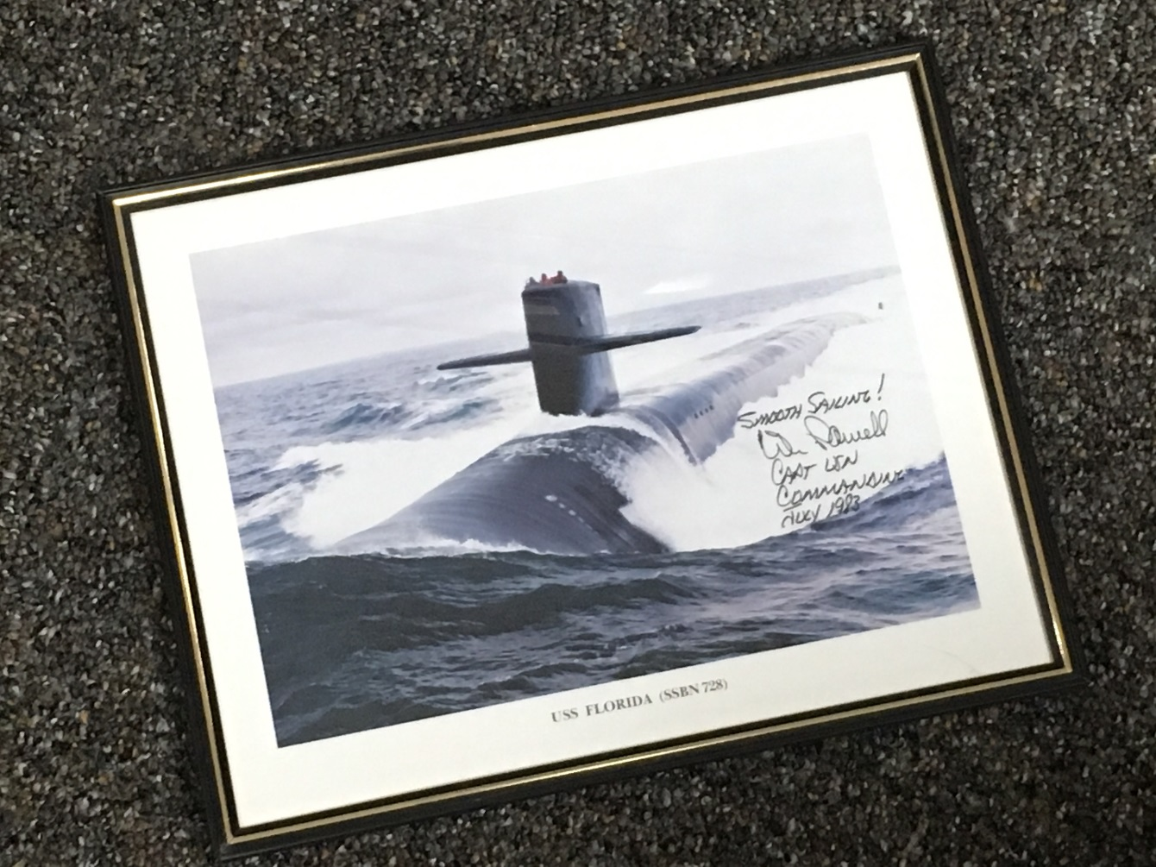
Way Back When…
There once was a sailor on a submarine…

Slide 3
Theory to Practice
Early in our education we were taught the theory and then we performed an experiment or series of calculations to demonstrate the application of the theory.
The U.S. Navy nuclear propulsion program performed “Theory to Practice” to demonstrate that book learning was applicable to the real world. For example, plot the engineroom steam cycle on an temperature-entropy (T-s) diagram or calculate the efficiency of a turbine.
Later in our education and as we moved into our professional lives, the strong connection between the theory and the application is not always evident. We spend more time developing and improving the theory, but it’s just as important to validate the theory.

Slide 4
LEU Conversion
Since 1979, the U.S. Department of Energy (DOE), National Nuclear Security Administration (NNSA), Office of Material Management and Minimization (M3) has been working to convert the world’s research reactors from highly enriched uranium (HEU) fuel (i.e. >20% enriched) to low enriched uranium (LEU) fuel (<20% enriched).
More than 90% of the research reactors have been converted or shutdown.
The conversion of four of the last five remaining U.S. HEU research reactors are likely to use LEU monolithic uranium-10% molybdenum (U-10Mo) as a future fuel supply.

Slide 5
USHPRR
Five U.S. high performance research reactor (USHPRR) designs remain to be converted to LEU.
Advanced Test Reactor (ATR) and the ATR Critical (ATRC) Facility at the Idaho National Laboratory (INL) near Idaho Falls, ID
University of Missouri Research Reactor (MURR) in Columbia, MO
Massachusetts Institute of Technology Reactor (MITR) at MIT in Cambridge, MA
National Bureau of Standards Reactor (NBSR) at the National Institute of Standards and Technology (NIST) Center for Neutron Research (NCNR) in Gaithersburg, MA.
High Flux Isotope Reactor (HFIR) at Oak Ridge National Laboratory (ORNL) near Oak Ridge, TN

Slide 6
LEU Conversion of the ATR
One major concern with the LEU conversion of ATR is the increased weight of the LEU fuel assemblies.
Nearly twice the weight of the HEU assemblies.
Replaces the existing 22 lb (10 kg) HEU fuel assemblies with 41 lb (18.6 kg) LEU assemblies.
Personnel interaction with the fuel assemblies has been the greatest concern.
Handling an ATR element will be a two man lift.

Slide 7
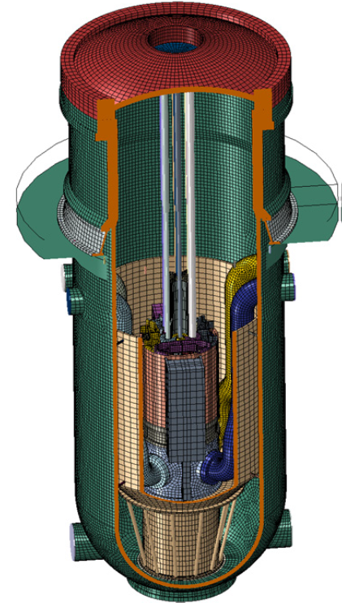
ATR Reactor Vessel Finite Element Model
A finite element analysis model was used to evaluate the effect of the increased weight ATR vessel, vessel support and anchors, and the core support structure components under static and seismic conditions.
All of the structural components analyzed to date are not significantly affected by the increased weight.

Slide 8
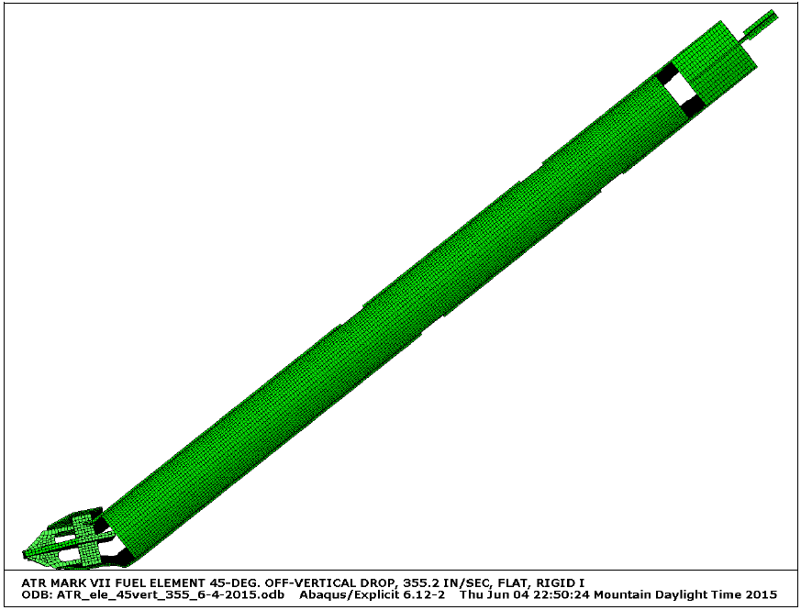
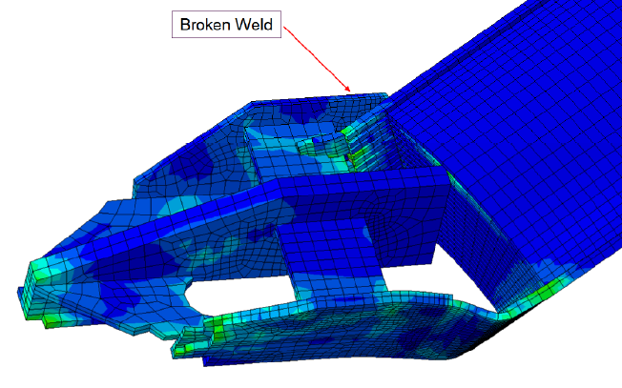
Updated ATR Fuel Element Drop Analysis
The drop analysis for both the HEU and LEU ATR fuel elements produced several scenarios in which the lower adapter (end box) breaks away from the side plates and is driven into the fuel plates.
The computer model represented the actual drop failures and damage accurately.

Slide 9
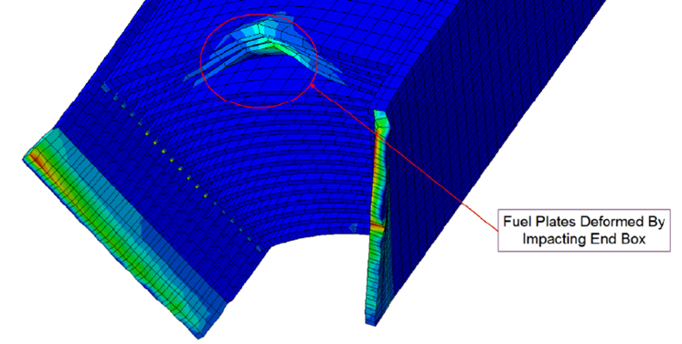
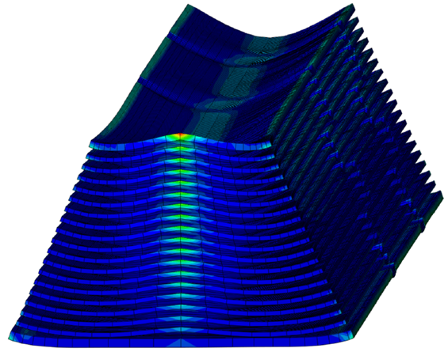
Drop Analysis - Continued
The computer analysis predicted
The adapter (end box) would fail at the side plate weld and would be driven into the fuel plates
The curved fuel plates would be flattened.

Slide 10
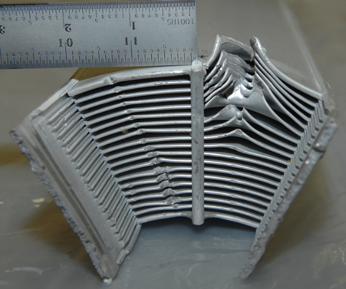
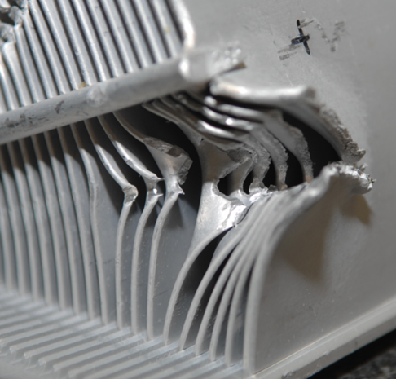
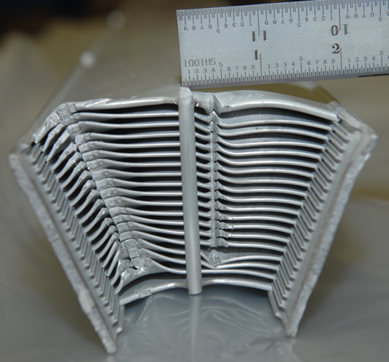
ATR Element After ATR Fresh Fuel Shipping Container Qualification Drop Tests
Qualification drop tests for the ATR Fresh Fuel Shipping Container (FFSC).
A FFSC was dropped numerous times under varying conditions, while loaded with an ATR fuel element.
No contamination was released during the drop tests.

Slide 11
Conclusions
Find a way to validate your theory.
Theory to Practice.
Questions?
Comments?

