Slide 1
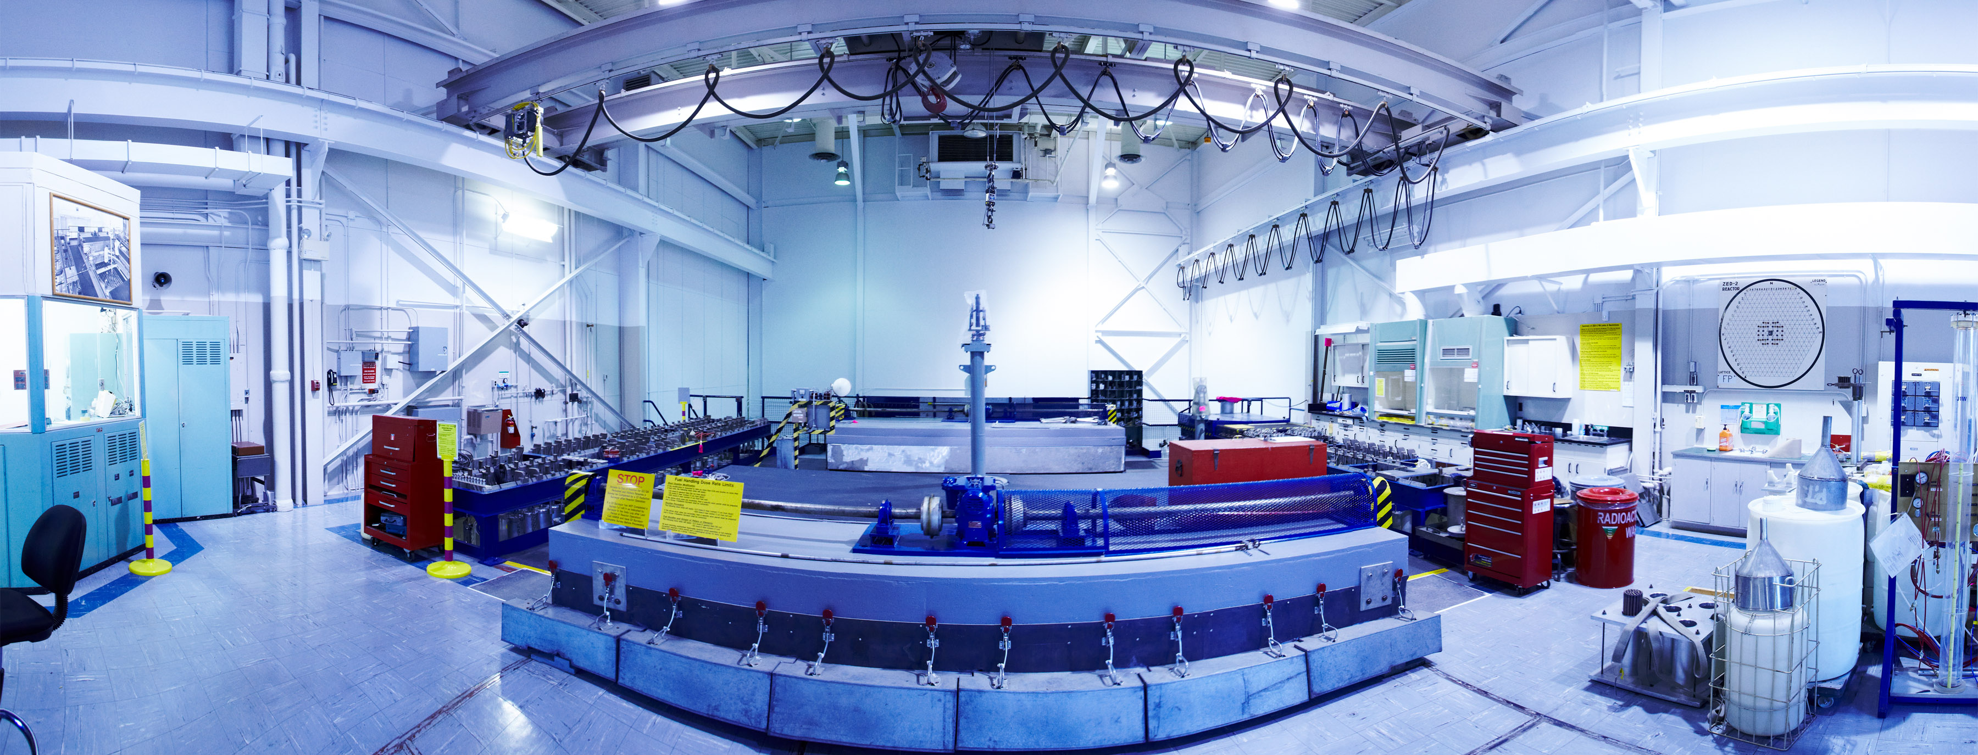
NEUTRON PERTURBATION DEVICE REACTIVITY WORTH MEASUREMENTS IN THE ZED-2 REACTOR
N. Lee, L. Li, J. Atfield, L. Yaraskavitch
TRTR Conference
Newport, Rhode Island
October 28th – November 1, 2018
Notes:
My first time attending TRTR,
I’d like to acknowledge authors, Liqian Li, Julian Atfield and Luke Yaraskavitch

Slide 2
Presentation Overview
ZED-2 Background
ZED-2 Experiments
Flux Perturber Background
Measuring the Flux Perturber Reactivity Worth
Flux Perturber Experiments
Questions

Slide 3
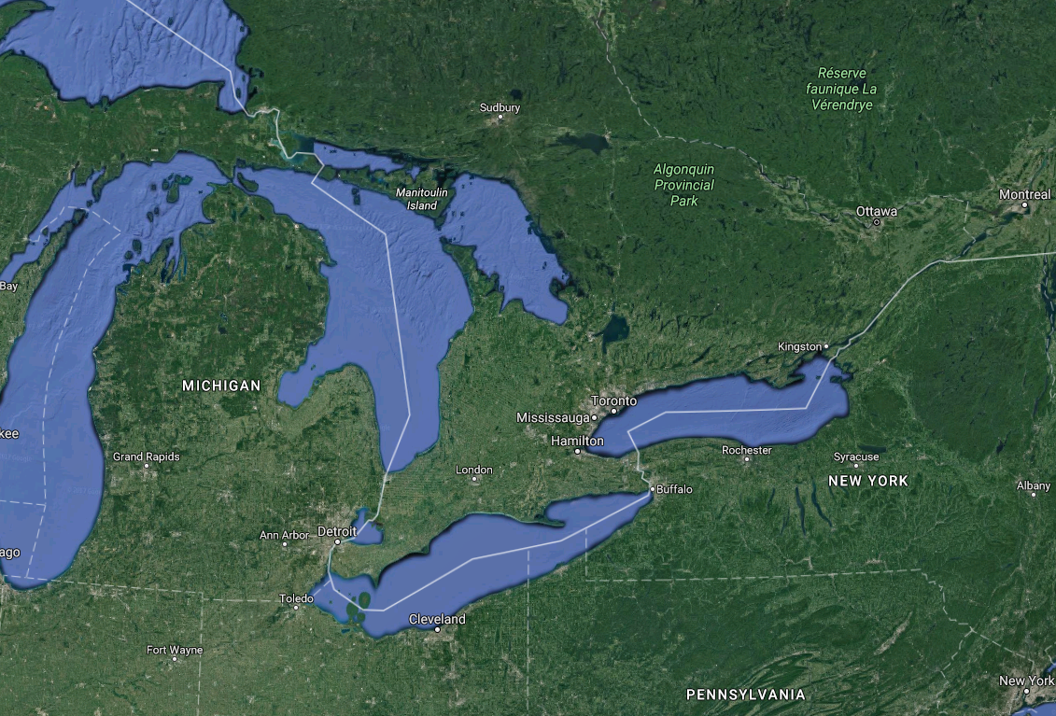
ZED-2 Background
Canadian Nuclear Laboratories (CNL) Location
Chalk River
Notes:
The ZED-2 Reactor is located on the Chalk River site of Canadian Nuclear Laboratories.
Chalk River is two hours north west of Ottawa.
A bit of history…ZED-2 is the successor to the ZEEP reactor which was the first criticality outside of the United States
Successor of ZEEP.

Slide 4
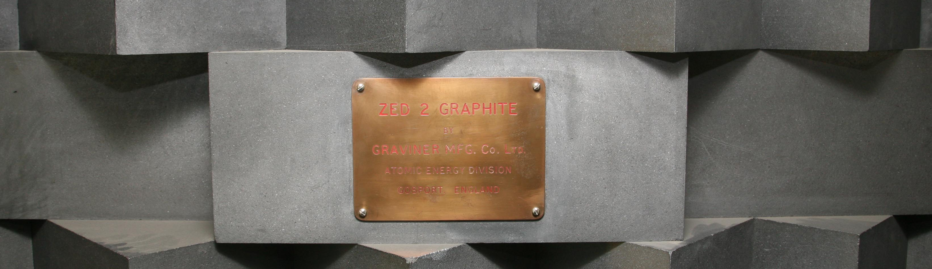
ZED-2 Background
ZED-2 Overview
First Criticality: September 7, 1960
Maximum Power: 200 W (indicated), 700 W (thermal)
Maximum Neutron Flux: 1×10⁹ n/cm²/s
Moderator: Heavy Water
Coolant: Air, Heavy Water, Light Water
Fuel: NU, LEU, Other Mixed Oxides
Notes:
ZED-2 is a low power research reactor which achieved its first criticality on September 7, 1960.
ZED-2 has a maximum indicated power of 200 W, and maximum thermal power of 700 W.
The maximum neutron flux is 1 x 10⁹ n/cm²/s.
The physics are similar to CANDU reactor with a heavy water (D₂O) moderator. The coolant can be varied for different experiments.
Some coolants include having the fuel channels void, or filled with heavy water or light water.
The ZED-2 Reactor has tested a wide range of fuels from natural uranium to slightly enriched uranium to mixed oxide fuels.
ZED-2 tests alternate fuels types such as uranium silicide and has recently tested advanced MOX fuels containing Pu-U and U-233-Th.
A bit of history…ZED-2 is the successor to ZEEP which was the first criticality outside of the United States

Slide 5
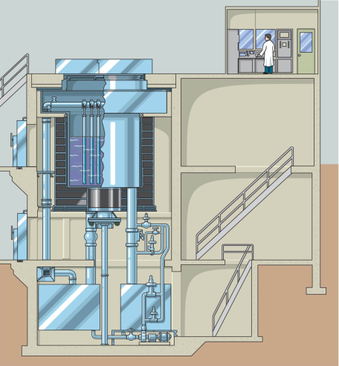
ZED-2 Background
ZED-2 Facility Layout
Control Room
Top Shields
Support Beams (15)
Calandria
Graphite Reflector
Dump Valves (3)
Dump Tanks (3)
Notes:
Here is a layout of the ZED-2 Facility. There are 15 stainless steel support beams that span the calandria
These stainless steel beams can be moved individually North and South.
By altering the beam positions and the position of rods on the beams we can allow for any size reactor pitch or core configuration inside the calandria.
The calandria is 3.3 m (10 ft) in diameter and 3.3 m (10 ft) in height and is surrounded by a graphite reflector on the sides and bottom.
The heavy water inventory is normally stored in the three dump tanks.
the reactor operates by pumping moderator from the three dump tanks through a series of valves into the calandria. Moderator can be pumped at different rates to control the rate of power during start up in the control room. ZED-2 goes critical based on the moderator height in the calandria and the submerged mass of fuel.
We require a predicted critical height before start up and perform an approach to critical with new cores. The average moderator critical height is usually between 150 cm and 200 cm.
ZED-2 shutdowns by dropping standby absorber rods located throughout the core and draining moderator through a series of valves. The standby absorber rods are not considered the main protection system since the worth of the absorber rods would depend on the core configuration. The main protection system is the three fast acting dump valves. The dump valves are 46 cm (18”) in diameter. The dump valves open upon any trip signal.
The Top Shields and shielding doors are in place during reactor operations by kirk key interlocks that are required to be in place for reactor start up.

Slide 6
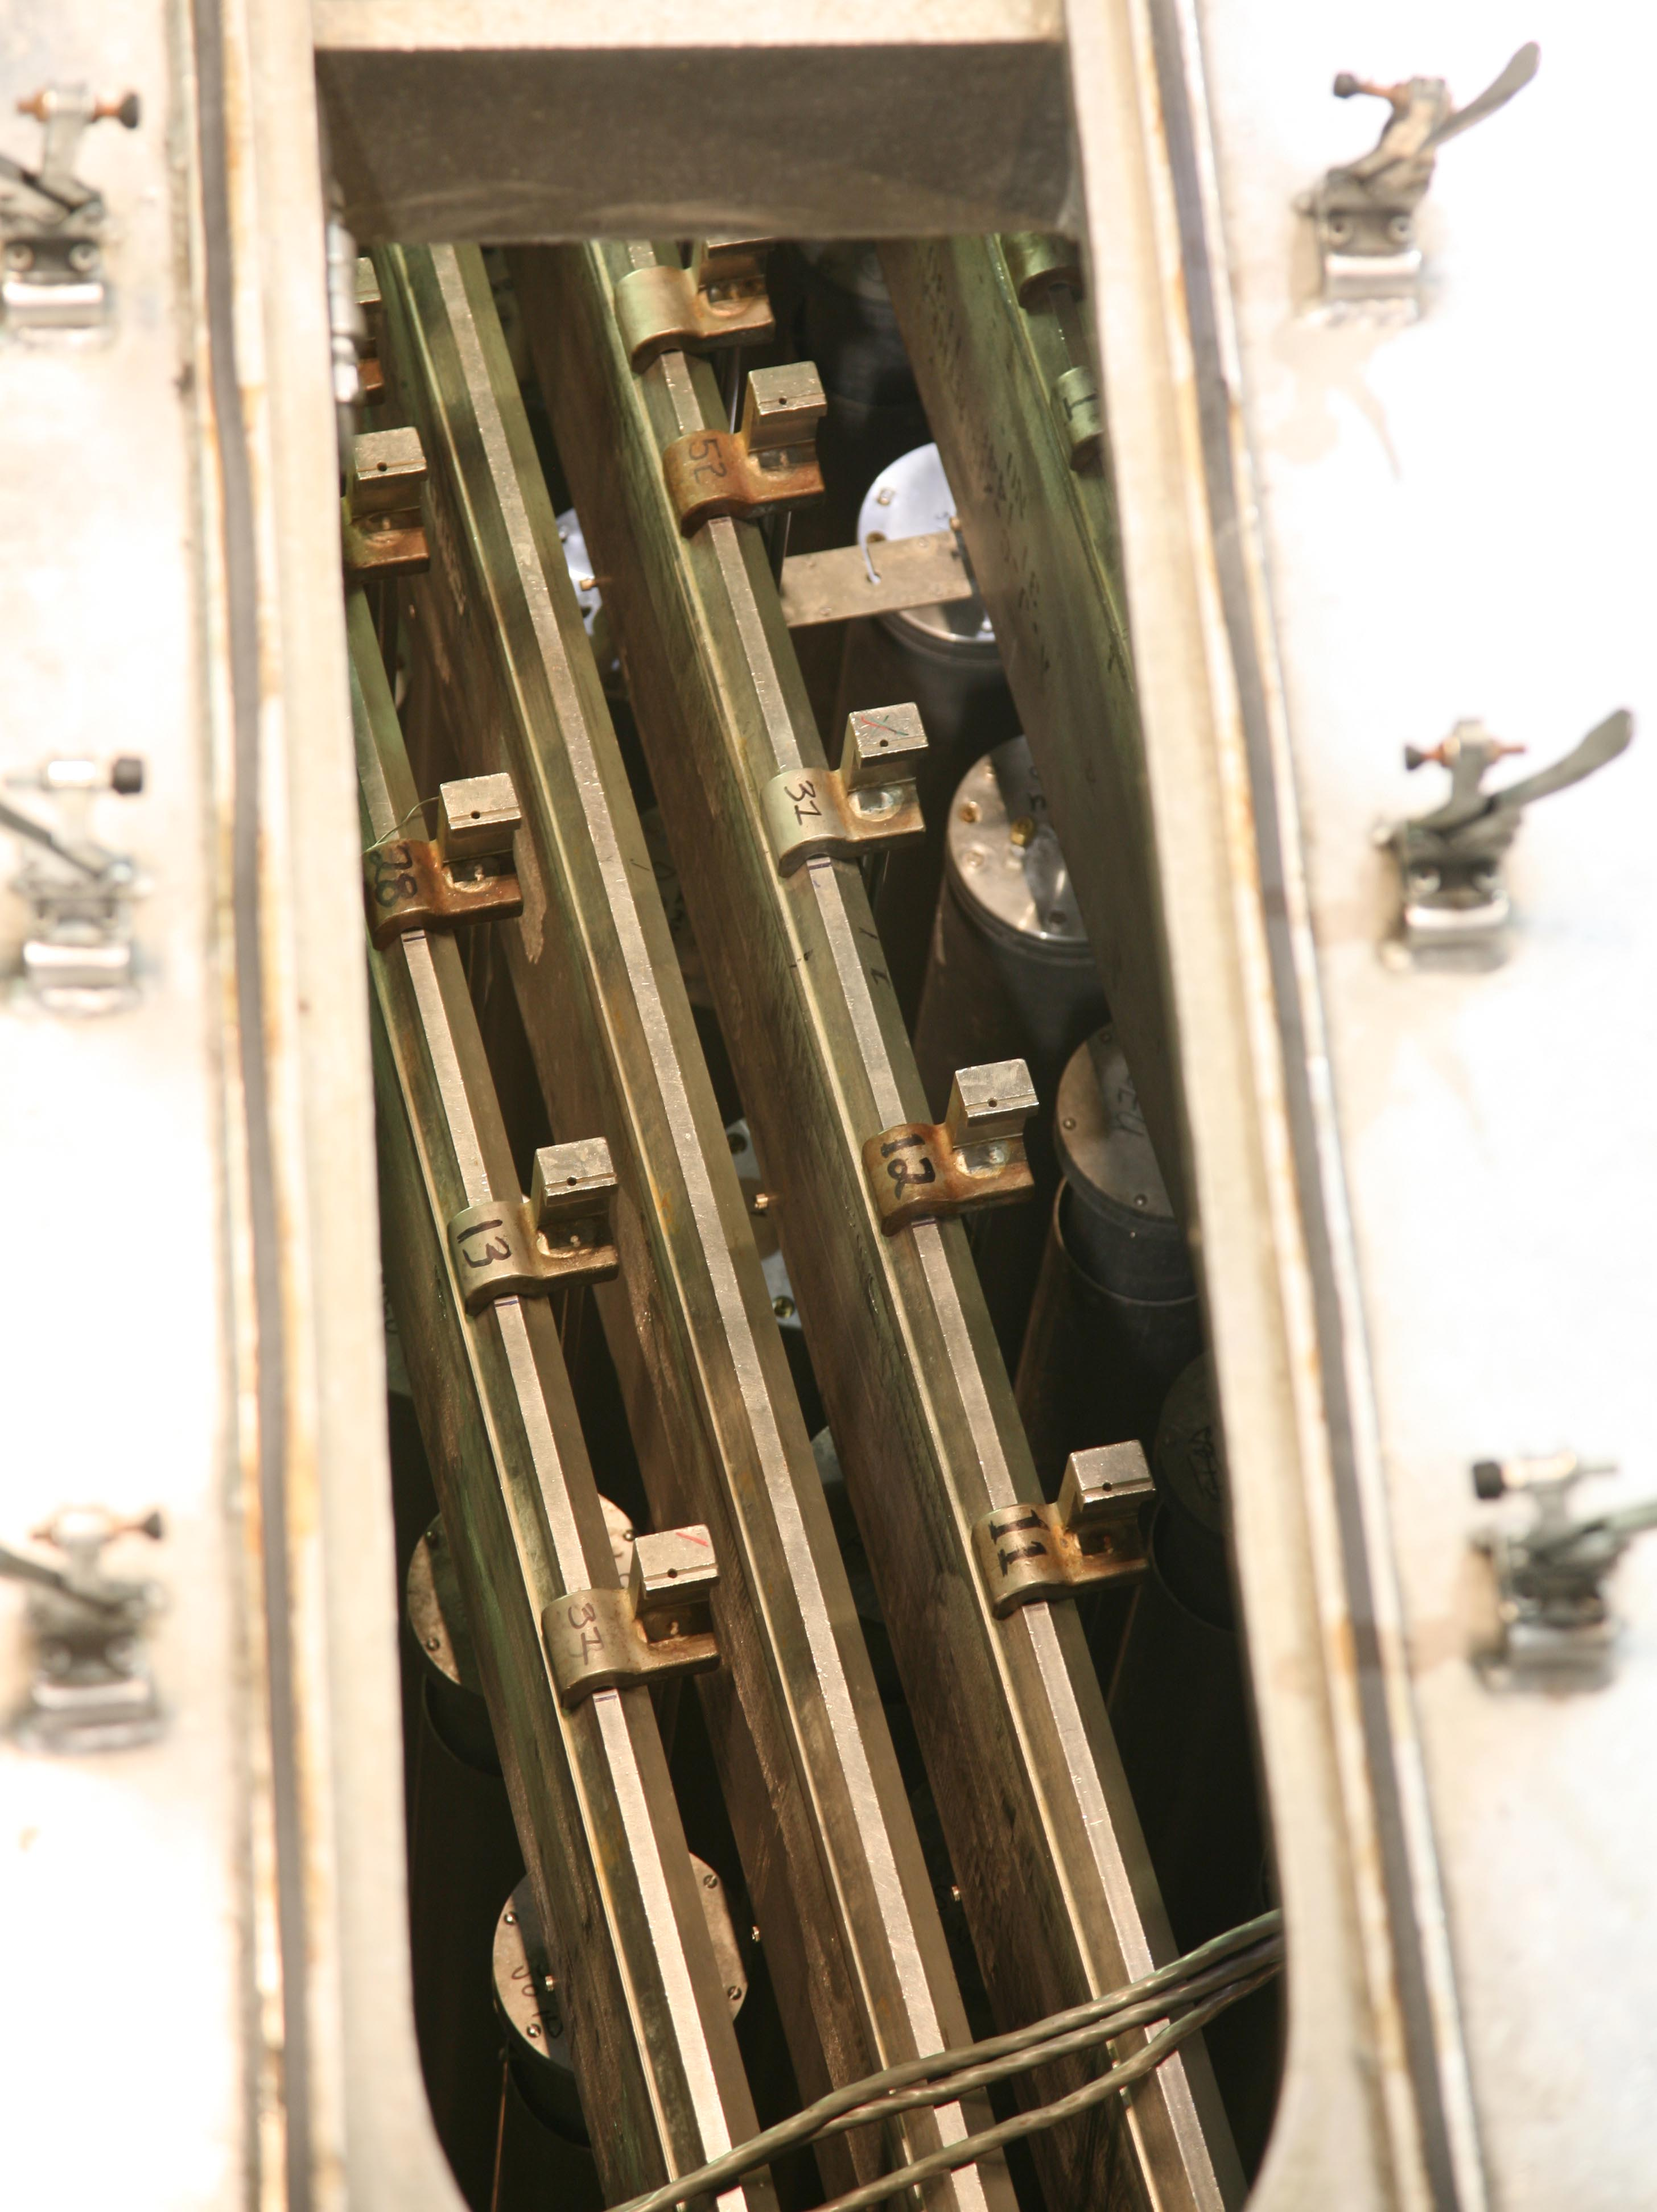
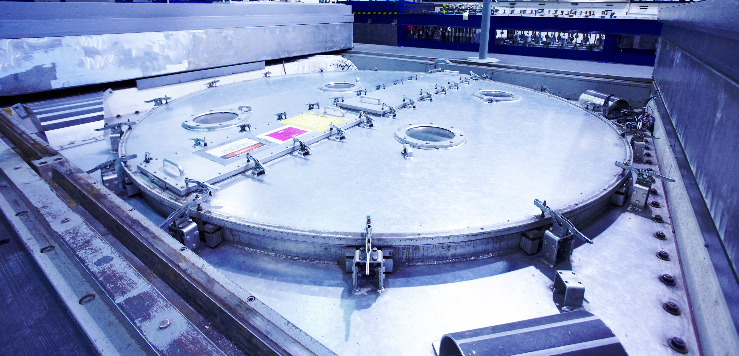
ZED-2 Background
ZED-2 Calandria
Notes:
Here is the top of the reactor.
The lid on the left spins and there are two ports that open to access the entire calandria.
The picture on the right shows the fuel support beams and how the fuel channels are hung from the beams.

Slide 7
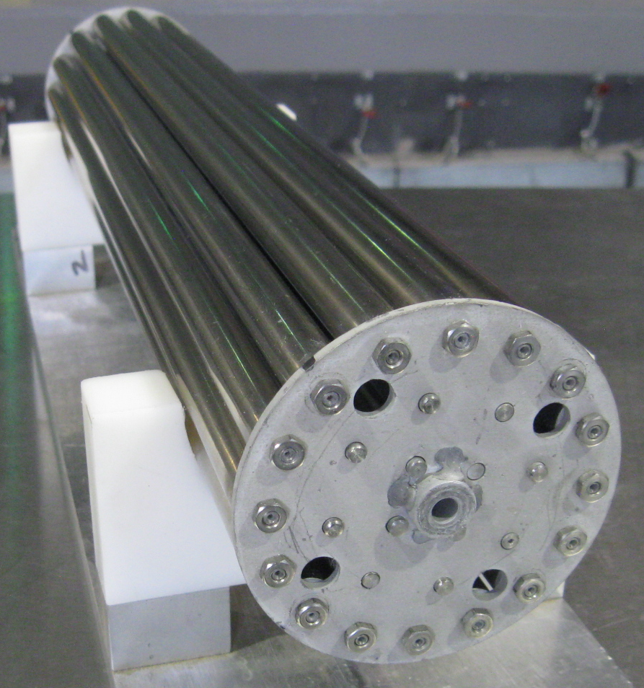
ZED-2 Fuel
Fuel Bundles
Natural UO₂ Bundles
  7, 19, 28, 37, 43 element
Uranium Carbide
Uranium Silicide
Uranium Metal
Mixed Oxides
  Pu-U (Depleted)
  U²³³-Th
  Pu-Th
Bundles with absorber elements
Enriched or reprocessed UO₂ bundles (LEU, RU)
Notes:
Operating at such low power means that the fuel is considered fresh since there are no significant fission product build ups.
In order to simulate the entire fuel cycle, ZED-2 has a wide variety of different fuel types, such as different mixed oxide fuels.
ZED-2 has tested the evolution of CANDU fuel from 7 element to 43 element bundles. All the fuel types are in a bundle form, as seen on the right.
A typical bundle is 50 cm in length and 10 cm in diameter. In ZED-2, there are usually five bundles assembled in each fuel channel.

Slide 8
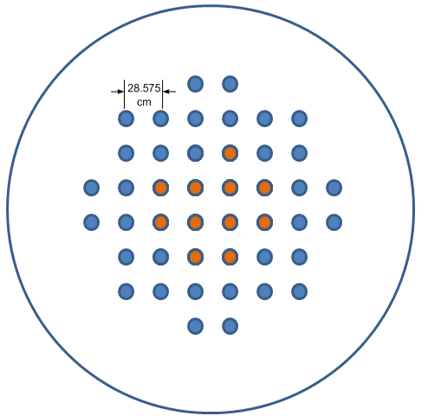
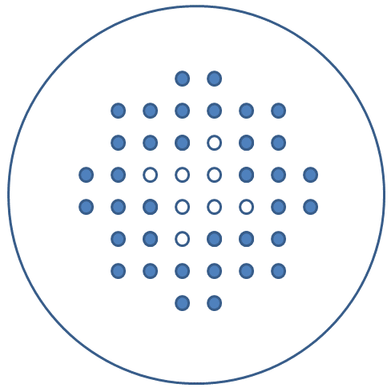
ZED-2 Experiments
Ongoing and Recent Experiments
Critical Height Measurements
  Reactor Physics Code Validations
3-D Kinetics Measurements
Reactivity Transient Measurements
  Transients utilizing Thoria-Based Fuels
  Flux Perturber Experiments
Notes:
Critical height measurements. Here, various critical configurations with different test fuel worth are measured, so that the critical configurations can be used for validation of reactor physics codes and nuclear data.
3D kinetics measurements. Multiple detectors are being used to monitor neutronics transients and observe the breakdown of the reactor point kinetics model. This data will be used to validate codes with transient capabilities.
Transient measurements. With varying test fuel contributions, the core reactivity is changed through moderator level change, rod drops, or channel flooding, and the resulting neutronics transient is observed. This data is being used to improve understanding of the transient phenomena of thoria based fuels. Another reactivity device is the flux perturber. This reactivity oscillator is being used to probe the kinetic behaviour of a given core.

Slide 9
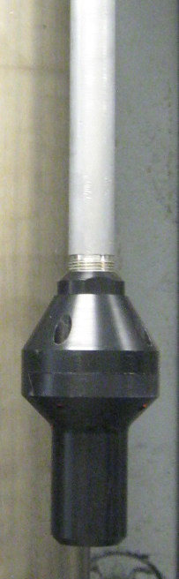
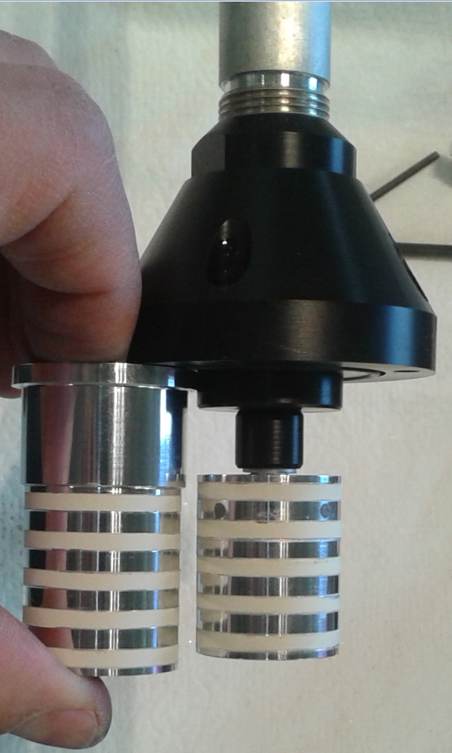
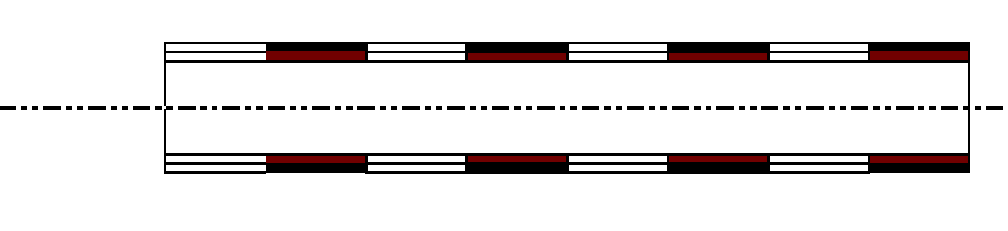
Flux Perturber Background
Physical Description
Periodic binary reactivity changing device
Constant time averaged reactivity worth
Less Neutron Absorption
More Neutron Absorption
Notes:
This is the ‘binary perturber’, capable of introducing periodic reactivity changes,
The perturber is designed to alternate between two states, characterized by a small change in its integral thermal neutron absorption.
We do this by using a neutron absorbing coating…
During operation, the perturber is driven according to a predetermined binary (non-sinusoidal) sequence that has been selected to sample a large range of frequencies,
The time in each state is balanced so as not to cause a drift in reactor power. That is, the time-averaged reactivity worth is constant.

Slide 10
Flux Perturber Background
Reactor Point Kinetics Analysis
Reactor Transfer Function
Reactivity
Power
Notes:
Why use the flux perturber?
Much of our recent work has been centered on fitting the kinetics parameters of a given system. The goal is to do this using integral measurements of the reactor response to input stimuli, rather than deriving them from computation and simulations.
According to the point kinetic model, the relative neutron flux of a core is a function of the input reactivity. By measuring the output relative flux change versus the input reactivity perturbation, the transfer function of the system can be identified. For a critical core in the point kinetics model, the transfer function in the complex-frequency domain can be expressed as follows…the transfer function

Slide 11
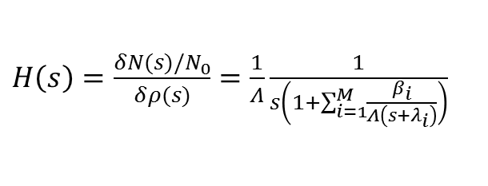
Flux Perturber Background
Reactor Point Kinetics Analysis
Reactor Transfer Function
Reactivity
Power
$H\left(s\right)=\frac{δN(s)/N_{0}}{δρ(s)}=\frac{1}{Λ}\frac{1}{s\left(1+\sum_{i=1}^{M}{\frac{β_{i}}{Λ\left(s+λ_{i}\right)}}\right)}$
Notes:
According to the point kinetic model, the relative neutron flux of a core is a function of the input reactivity. By measuring the output relative flux change versus the input reactivity perturbation, the transfer function of the system can be identified. For a critical core in the point kinetics model, the transfer function in the complex-frequency domain can be expressed as follows…the transfer function
Bring attention to rho
Also can touch on prompt N lifetime and delayed N fraction

Slide 12
Reactivity Worth
Previous Method for Determining Flux Perturber Reactivity Worth
ZED-2 Accurate Height Probe Measurement
  Relative Height Accuracy of ±0.020 cm
Level Coefficient of Reactivity
  Varies between 0.15 mk/cm to 2.2 mk/cm
Reactivity Accuracy at Critical
  3 µk to 44 µk
Flux Perturber Reactivity Worth
  ~ 100 µk
Notes:
If we want to extract and fit the various kenetics parameters, we require a value of reactivity for the perturbation.
Historically the flux perturber’s reactivity worth has been measured by fixing it in the least N absorbing state and bringing ZED-2 critical by pumping D₂O moderator into the calandria vessel to a critical steady state power. The ultimate height of the moderator is of course dependent on the core composition and geometry. The moderator height is then measured by lowering the accurate height probe which is a drum-and-cable drive system.
Once the probe makes electrical contact with the moderator surface, the height is displayed and recorded. Then the flux perturber is selected to change to its most N absorbing state. This causes a small negative reactor transient which is compensated for by pumping additional water into the calandra and the reactor is brought back to critical.
The accurate height is then re-measured. The difference between the 2 moderator heights for the 2 perturber states can then be calculated.
Then the level coefficient of reactivity(LCR) is applied to this difference which gives us the reactivity worth of the perturber.
Unfortunately, the accurate height probe has an accuracy of ± 0.020 cm Therefore, the reactivity worth of a change in moderator level near critical has an accuracy in the range of 3 to 44 μk due to the height measurement alone.
This is unsatisfactory for use in determining the reactivity worth of the binary perturber, which experience has shown to have a maximum worth of $\sim$100 μk (dependent on core configuration and perturber location). Therefore, a new accurate relative water level measurement system, or $∆H_{C}$ system is required

Slide 13
Reactivity Worth
New Method for Determining Flux Perturber Reactivity Worth
Design Requirements
  Accuracy: 1.0 µm
  Set Range: 0.7 cm
  Maneuverable Range: 1.0 m
  Handle High Radiation Levels
Notes:
New device requirements
- 1um or better height accuracy
- range of ~0.7cm
- Must be flexible enough to be set to accommodate critical heights differing by up to 1 meter.
-Radiation Hardened
Summary- High accuracy, large range, and exposure to neutron and gamma ray irradiation are the main challenges for the measurement system.

Slide 14
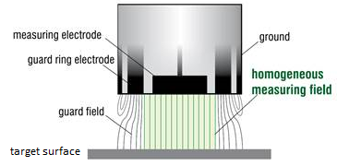

$ΔH_{c}$ System
Principle of Operation
Displacement Sensor
No active electronics in radiation areas
Resolution of 2.25 nm
Notes:
Selection of sensor
Ultrasound and laser are commonly used for accurate water level measurement. They both use the timing of the reflection beam and the wave transmission speed to calculate distance. The accuracy of ultrasound systems is usually in the centimeter or millimetre ranges, too coarse for this application.
Laser systems can have micrometer accuracy however, because of the potential radiation damage to the electronic components, it is not suitable to put a laser system close to the water surface inside the reactor.
For our application, a novel system was developed using a displacement sensor based on measurement of the capacitance between two parallel surfaces. A sensor was selected from Micro-Epsilon, Figure. The sensor itself has no active electronic components so it can be placed close to the core, while the preamplifier is remotely located safely away from radiation damage. Selected sensor has a resolution of 2.25 nm. ( The type CS3 sensor has a resolution of 2.25 nm)

Slide 15
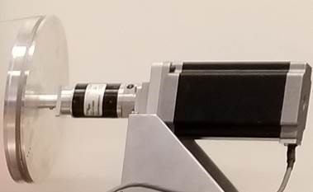
$ΔH_{c}$ System
Principle of Operation
Maneuverable float with displacement sensor
Notes:
The sensor would typically operate on a target surface of regular water, which is electrically conductive due to the presence of impurities.
However, ZED-2 uses high purity heavy water, which behaves as an electrical insulator, and cannot function as the sensor target. Therefore, a hollow aluminum float was designed to be the sensor target, which relays the water level variation to the sensor. The float is a long cylindrical tube, weighted at the bottom so that the centre of gravity is well below the centre of buoyancy.
This ensures the float stays vertical in the water, with its top surface horizontal. Correspondingly, the sensor is mounted at the lower end of a long hollow hanger which is suspended from its top. Gravity aligns the hanger vertically, so that the working surface of the sensor sits horizontally to face the top horizontal surface of the float. A plastic holder was designed to keep the floater aligned under the sensor during operation, and to retrieve the float with the hanger when the unit is withdrawn.
The float is designed to sit in the heavy-water moderator with the top surface 5 cm above the moderator surface to reduce the likelihood of an accidental submersion. This leaves a comfortable margin with respect to the rate of moderator addition near critical, which is $\sim$0.7 cm/min.
The wide range of critical heights can be adjusted for by using the sensors associated stepper motor and pulley system. These are used to make gross changes to the float/sensor assembly and place them in at an appropriate height for active measurement.

Slide 16
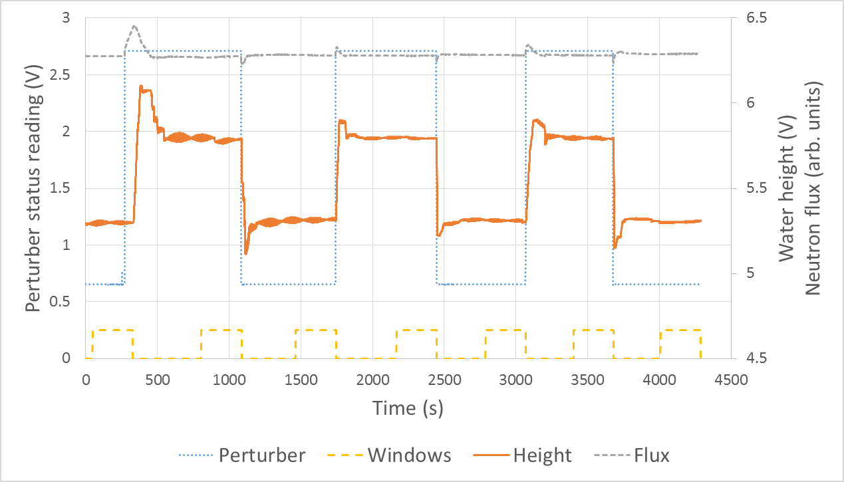
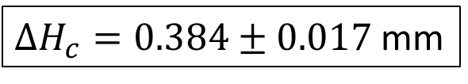
Experiment
$ΔH_{c}=0.384±0.017$mm
Flux Perturber $ΔH_{c}$Readings
Notes:
The critical moderator level was measured with the binary perturber in both the minimum and maximum absorbing state
The four-trace-plot in this figure contains the perturber status voltage signal in light blue (high indicates minimum absorption), the neutron flux reading voltage signal in grey, the water level sensor ($∆H_{C}$) signal in orange (higher voltage indicates lower water level), and a window signal in yellow, which marks the area for calculating the average water level.
four sections where the perturber was at the maximum absorption state, and three sections at the minimum.
The windows marked the 280 s periods where the water was kept steady for water level sensor signal averaging.
What is clear from this figure is that the readings for the same perturber states are consistent.

Slide 17
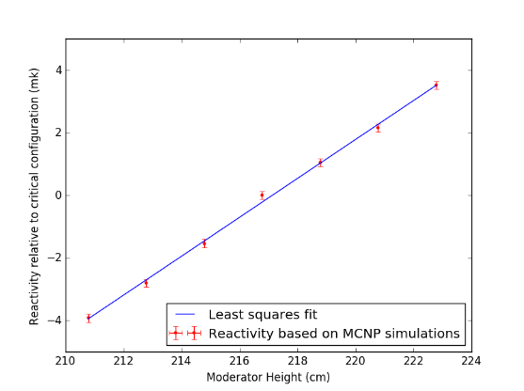
New Reactivity Worth
Analysis – Level Coefficient of Reactivity
LCR: 0.622 ± 0.012 mk/cm
Using the calculated LCR and moderator height difference between the two perturber states the reactivity worth is found to be 23.9 ± 1.2 μk.
Notes:
$ΔH_{c}=0.384±0.017$mm

Slide 18
ZED-2 Flux Perturber Experiments
Reactor Point Kinetics Analysis
Reactor Transfer Function
Reactivity
Power
$H\left(s\right)=\frac{δN(s)/N_{0}}{δρ(s)}=\frac{1}{Λ}\frac{1}{s\left(1+\sum_{i=1}^{M}{\frac{β_{i}}{Λ\left(s+λ_{i}\right)}}\right)}$
Notes:
With a far more accurate measurement of the difference in moderator level and the corresponding confidence in the reactivity worth of the perturbation we can then analyze the measured transfer function.

Slide 19
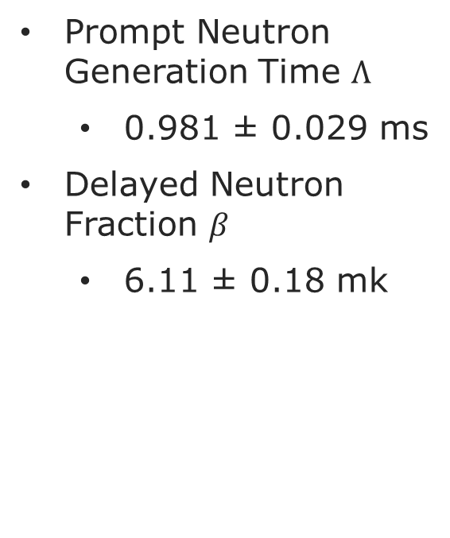
Analysis
Fitting The Measured Transfer Function
Prompt Neutron Generation Time $Λ$
  0.981 ± 0.029 ms
Delayed Neutron Fraction $β$
  6.11 ± 0.18 mk

Slide 20

$ΔH_{c}$ System and the Flux Perturber
Summary
The flux perturber, a two state reactivity oscillator, had such a small reactivity worth that existing methods couldn’t accurately measure it.
  Small worth ideal for studying kinetics at critical
Delta height system developed to determine the reactivity worth of the flux perturber through relative moderator level measurements
Accurate reactivity worth allowed for improved fit of reactor transfer function, yielding kinetics parameters
Can now apply methodology to other cores

Slide 21
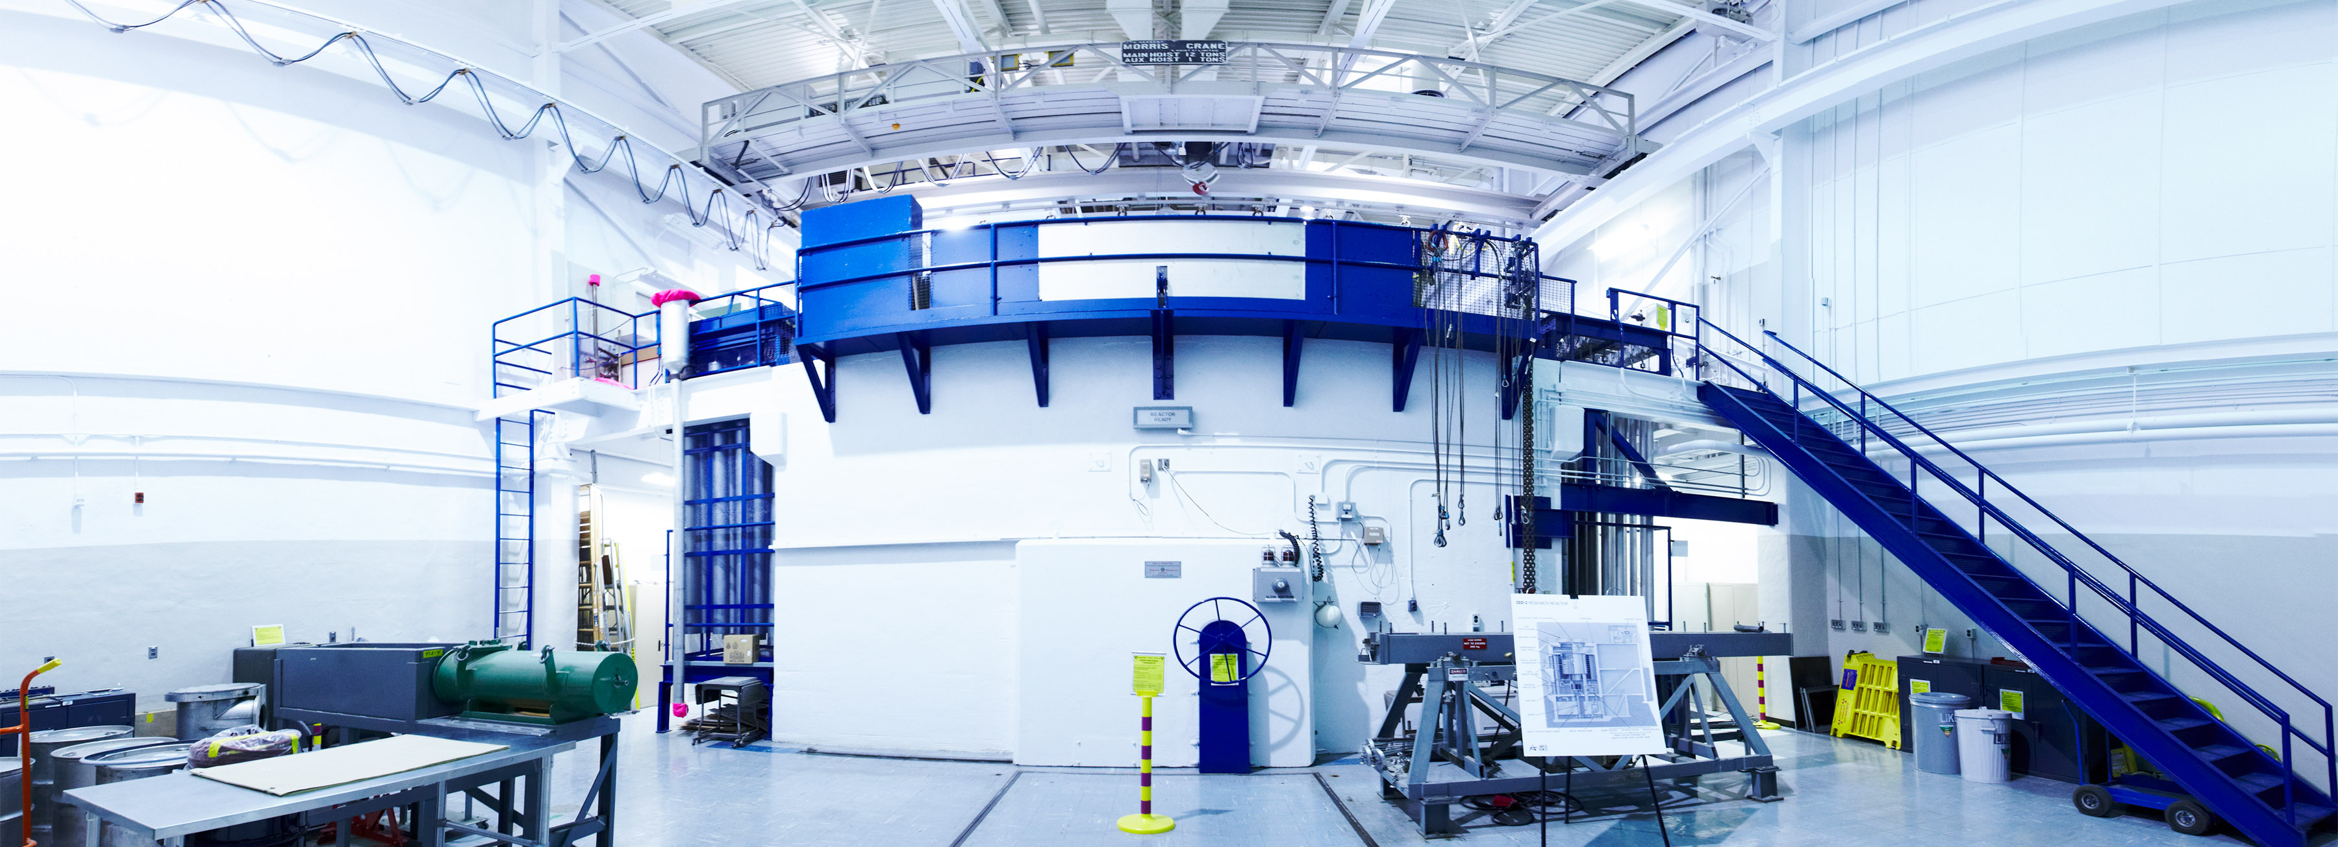

Thank you.
Questions?
Nathan Lee
R&D Technologist/ZED-2 Operator ZED-2 Reactor
nathan.lee@cnl.ca
Notes:
Thank you for this opportunity to share some of our recent work.

Slide 22

Additional Information
Notes:
For best results, please send the large top image to the back layer. Choose “Arrange” then select “Send to Back”.
This slide is not available in the Master. To add slides to you deck, simply duplicate the slide itself.

Slide 23
ZED-2 Flux Perturber Experiments
Experimental Setup

Slide 24
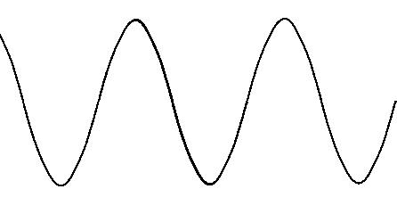
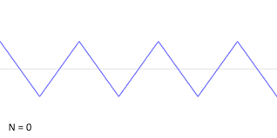
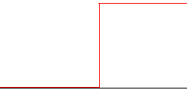
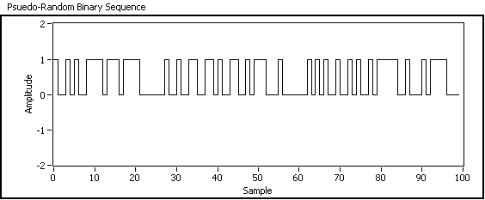
ZED-2 Reactor Additional Information
Flux Perturber Input Signals
Single Frequency
~Single Frequency
Step Change
Pseudo Random Binary Sequence (PRBS)

Slide 25
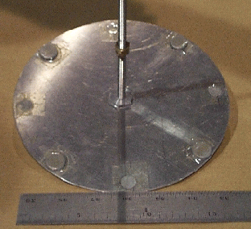
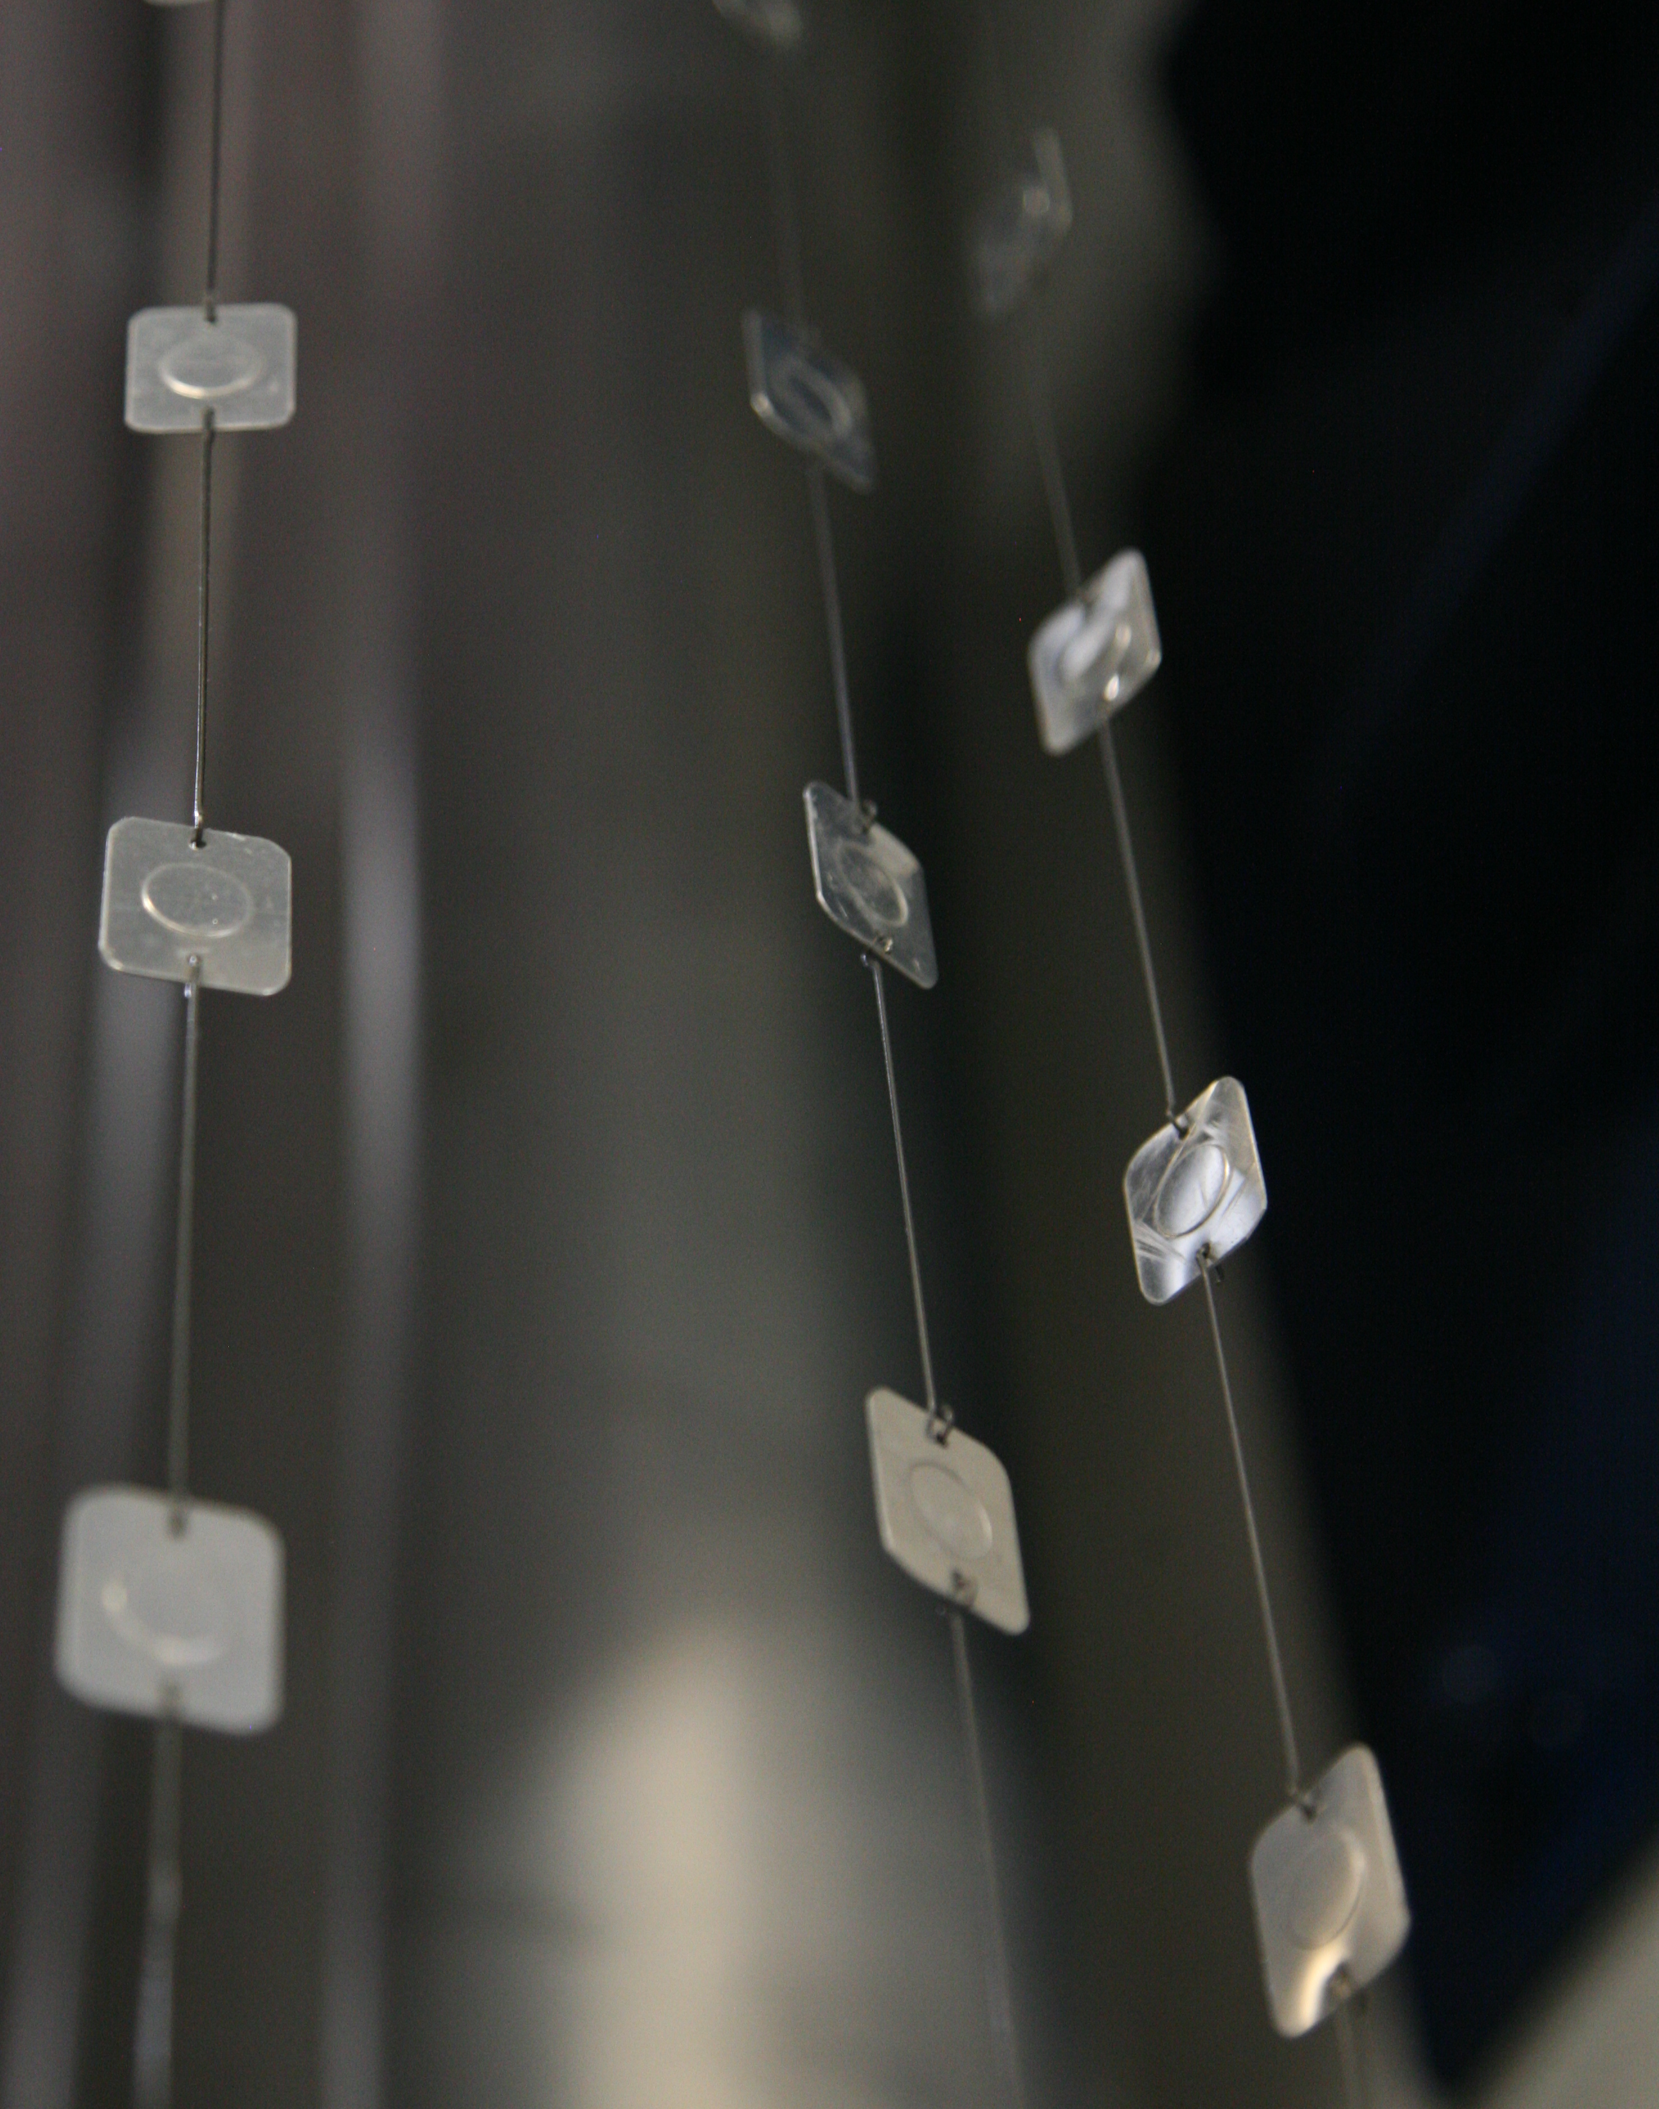
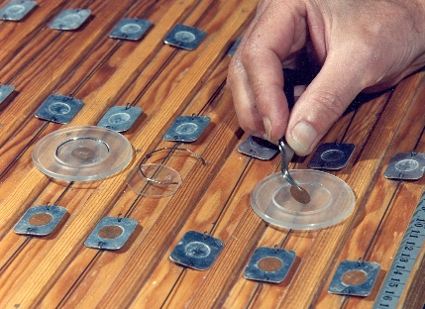
ZED-2 Reactor Additional Information
ZED-2 Counting Laboratory
Detectors are germanium- and sodium-based (scintillation detector with photomultiplier tubes)
Reference Wheel
Foil Hangers
Foil Counting Station
Copper Foils

Slide 26
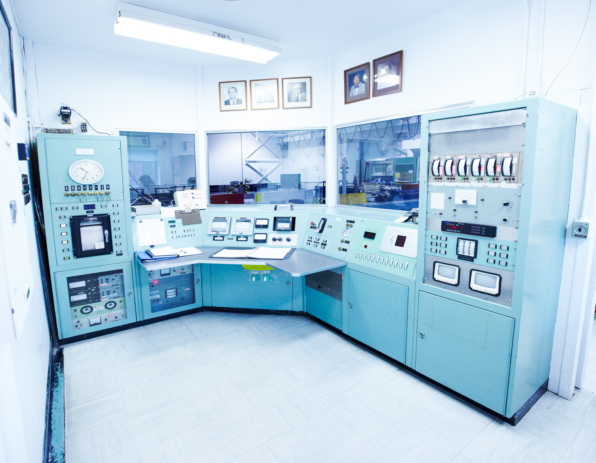
ZED-2 Background
ZED-2 Control Room

Slide 27
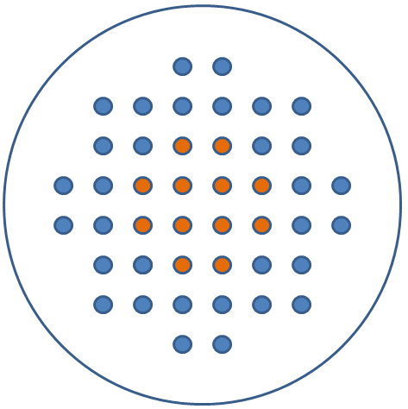
ZED-2 Experiments
Core Configurations

Slide 28
ZED-2 Experiments
Flux Maps

Slide 29
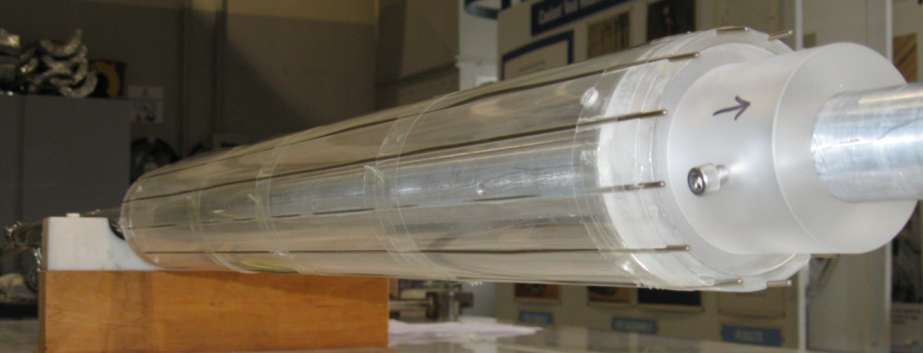
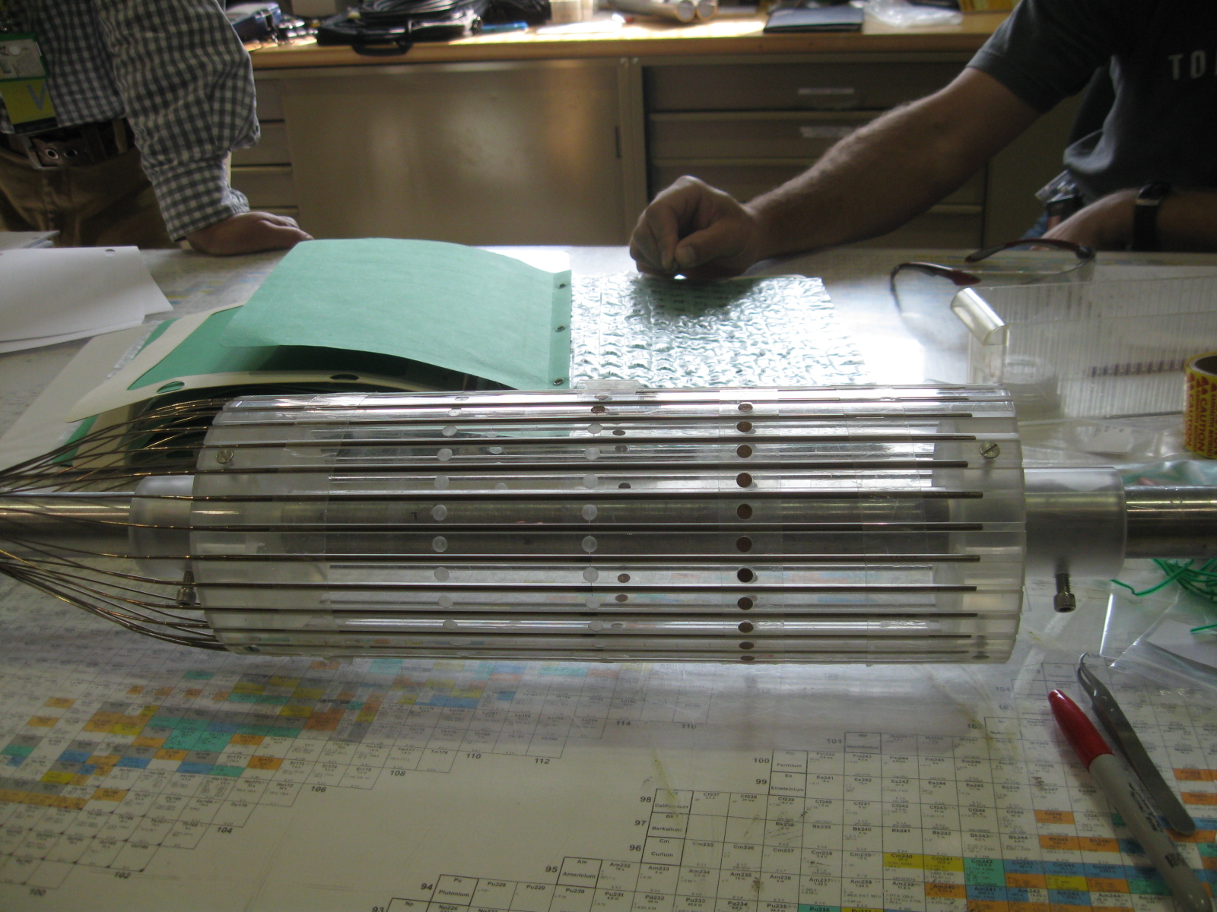
ZED-2 Experiments
Self Powered Flux Detector Calibrations
Calibrate 30 Vanadium Detectors per reactor operation
Calibrate an entire CANDU 6 Reactor fleet in less than 1 week
ZED-2 Counting Laboratory aids in calibrating detectors

Slide 30
ZED-2 Experiments
Ion Chamber Calibrations
Low Flux (Maximum 10⁹ nHcm⁻²Hs⁻¹)
Same Day Handling
ZED-2 Counting Laboratory Support
Signal and High Voltage Cables
Positioning Clamp
Suspension Cable
Ion Chamber
Lead Weight

Slide 31
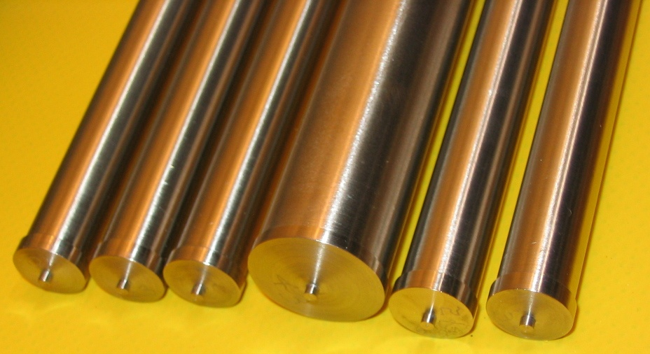
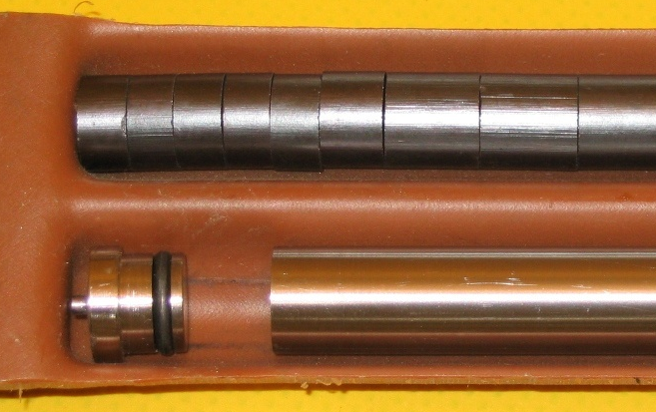
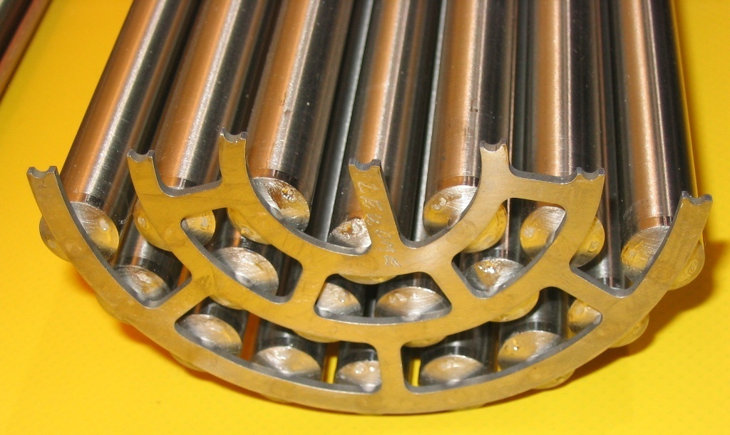
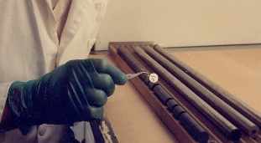
ZED-2 Reactor Additional Information
Demountable Bundle

