Slide 1
Model Validation at the Advanced Test Reactor
Thomas J. Eiden
Idaho National Laboratory
TRTR Annual Meeting 2018
Newport, RI

Slide 2
Advanced Test Reactor - Critical
ATRC is the zero-power “sister” reactor to ATR.
Nearly identical
ATRC has a variety of uses:
Physics testing
Model benchmarking
Dosimetry
And much, much more

Slide 3
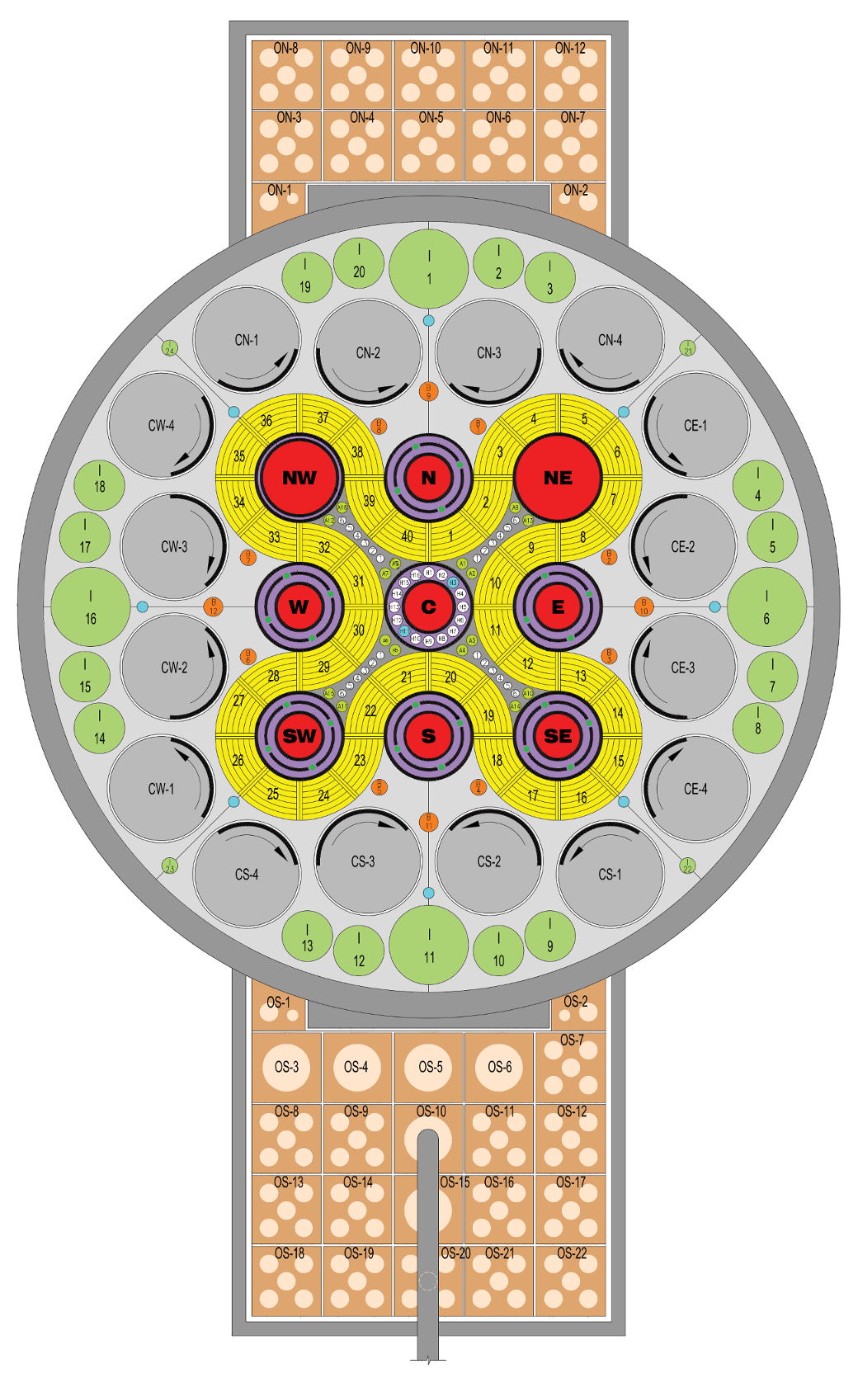
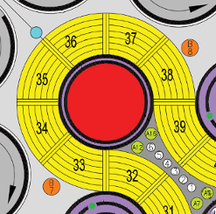
ATR Fuel Pattern
Experiment
Notes:
Note obligatory 90’s word art

Slide 4
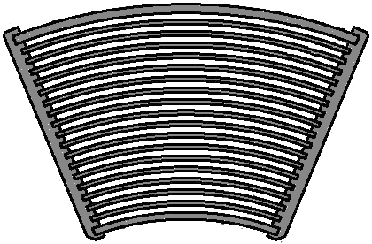
ATR Fuel Element Coolant Channels
Channel 19
Channel 15
Channel 11
Channel 6
Channel 2
Notes:
Fission wires -

Slide 5
Experiment Setup
-14.78”
-22.00”
-16.78”
-12.78”
-4.58”
3.62”
11.82”
12.82”
22.00”
0% Hf 100% Al
100% Hf
0% Al
70% Hf
30% Al
0% Hf
100% Al
Shroud
22.64g U²³⁵ 6.52g Hf
9.06g U²³⁵ 446.00g Hf
24.91g U²³⁵ 446.00g Hf
9.06g U²³⁵ 3.26g Hf
36.24g U²³⁵ 6.52g Hf
Experiment

Slide 6
Prediction of Local to Average Axial Flux with MC21

Slide 7
Prediction of Local to Average Axial Flux with MC21
Notes:
Point out reason for Ch. 19 in FE39

Slide 8
Results of ATRC Flux Run
Notes:
3% error bars because Tomberlain said so

Slide 9
Results of ATRC Flux Run

Slide 10
MC21 Prediction and ATRC Data Comparison

Slide 11
MC21 Prediction and ATRC Data Comparison

Slide 12
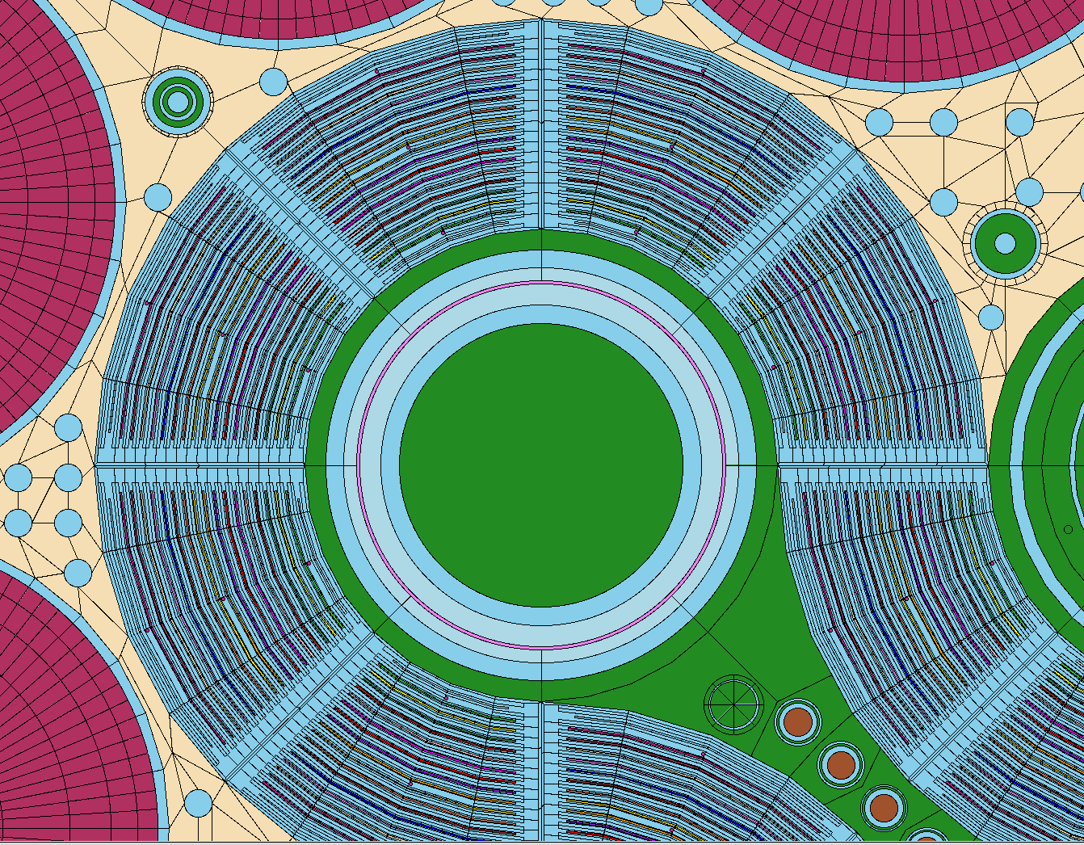
HELIOS Model Validation and Biasing
HELIOS (Studsvik) is currently used to perform core physics analysis at ATR
Two-dimensional transport code
48” test train is “pancaked” into 1 cm wafer
ATRC “run” is benchmarked against actual ATRC run
Model is sometimes “corrected” to ATRC measured worth
Notes:
600 kW max power

Slide 13
Uncertainties
Always improving: quantifying biases via as-run analyses.
ASUDAS Average Power (MW) | HELIOS Average Power (MW) | Difference (%)
20.00 | 17.81 | -11.93
Notes:
Maximum lobe power uncertainty is 8.5%

Slide 14
Questions

